Slide 1
Umple Mini-Course
Part 2: Building On the Basics
Timothy C. Lethbridge, I.S.P, P.Eng.
University of Ottawa, Canada
tcl@eecs.uottawa.ca
http://www.umple.org

Slide 2
Derived attributes
These generate a get method that is calculated.
class Point
{
// Cartesian coordinates
Float x;
Float y;
// Polar coordinates
Float rho =
{Math.sqrt(Math.pow(getX(), 2) + Math.pow(getY(), 2))}
Float theta =
{Math.toDegrees(Math.atan2(getY(),getX()))}
}

Slide 3
Multi-Valued Attributes
Limit their use. Associations are generally better.
class Office {
Integer number;
Phone[] installedTelephones;
}
class Phone {
String digits;
String callerID;
}

Slide 4
Keys
Enable Umple to generate an equals() and a hashcode() method
class Student {
Integer id;
name;
key { id }
}
The user manual has a sports team example showing keys on associations too
Note how this feature is not inherited from UML

Slide 5
Singleton Pattern
Standard pattern to enable only a single instance of a class to be created.
  private constructor
  getInstance() method
Declaring in Umple
class University {
singleton;
name;
}

Slide 6
Delegation Pattern
A class calls a method in its ‘neighbour’
class RegularFlight {
flightNumber;
}
Class SpecificFlight {
* -- 1 RegularFlight;
flightNumber = {getRegularFlight().getFullNumber()}
}
Full details of this example in the user manual

Slide 7
Basic Constraints
Shown in square brackets
  Code is added to the constructor and the set method
class X {
Integer i;
[! (i == 10)]
}
We will see constraints later in state machines

Slide 8
Tips for Building a Model from Requirements
Skip the ahead to slides on state machines if time is short: Students read this at home
  Identify a first set of candidate classes
  Focus on the core 1-2 classes
    Add associations and attributes
    Find generalizations and apply patterns as needed
    Iterate for the other classes
  Then work on methods
  Iterate until the model is satisfactory

Slide 9
Discovering Classes in Requirements
  Look at a source material such as a description of requirements
  Extract the nouns and noun phrases
  Eliminate nouns that:
    are redundant (same meaning)
    represent instances (e.g. specific people)
    are vague or highly general (e.g. ‘Object’)
    not needed in the application
  Pay attention to classes in a domain model that represent types of users or other actors
    They may or may not be needed

Slide 10
Identifying Associations and Attributes
  Start with classes you think are most central and important
  Decide on the clear and obvious data it must contain and its relationships to other classes.
  Work outwards towards the classes that are less important.
  Avoid adding too many associations and attributes to a class
    A system is simpler if it manipulates less information

Slide 11
Tips about identifying and specifying valid associations
  Specify the multiplicity at both ends
  Use role names if necessary

Slide 12
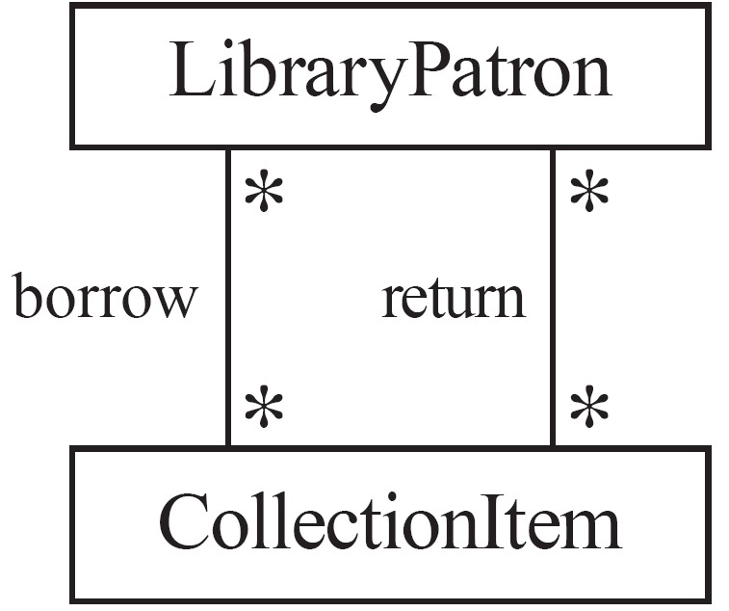
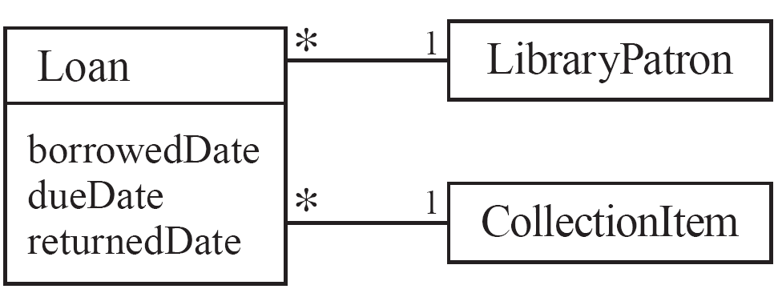
Actions versus associations
  A common mistake: to represent actions as if they were associations
Better: The
borrow
operation creates a
Loan
, and
Bad, due to the use of associations
the
return
operation sets the
returnedDate
that are actions
attribute.

Slide 13
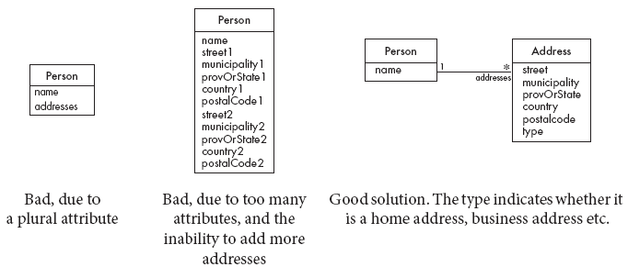
Tips About Identifying valid attributes
  It is not good to have many duplicate attributes
  If a subset of a class’s attributes form a coherent group, then create a distinct class containing these attributes

Slide 14
Time for test 3
Click on the following link for Test 3
https://www.surveymonkey.com/r/Test3x-UmpleIsrael

Slide 15
Basics of State Machines
  At any given point in time, the system is in one state.
  It will remain in this state until an event occurs that causes it to change state.
  A state is represented by a rounded rectangle containing the name of the state.
  Special states:
    A black circle represents the start state
    A circle with a ring around it represents an end state

Slide 16
Garage Door State Machine
class GarageDoor{
status {
Open {
buttonOrObstacle -> Closing;
}
Closing {
buttonOrObstacle -> Opening;
reachBottom -> Closed;
}
Closed {
buttonOrObstacle -> Opening;
}
Opening {
buttonOrObstacle -> HalfOpen;
reachTop -> Open;
}
HalfOpen {
buttonOrObstacle -> Opening;
}
}
}

Slide 17
Events
An occurrence that may trigger a change of state
  Modeled in Umple as generated methods that can be called
Several states may be able to respond to the same event

Slide 18
Transitions
  A change of state in response to an event.
    It is considered to occur instantaneously.
  The label on each transition is the event that causes the change of state.

Slide 19
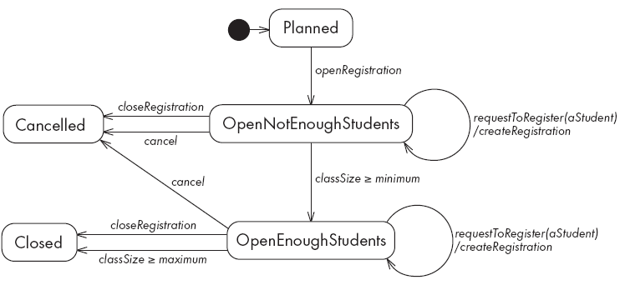
State Diagrams – an Example with Conditional Transitions

Slide 20
Actions in State Diagrams
  An action is a block of code that must be executed effectivey instantaneously
    When a particular transition is taken,
    Upon entry into a particular state, or
    Upon exit from a particular state
  An action should consume no noticeable amount of time

Slide 21
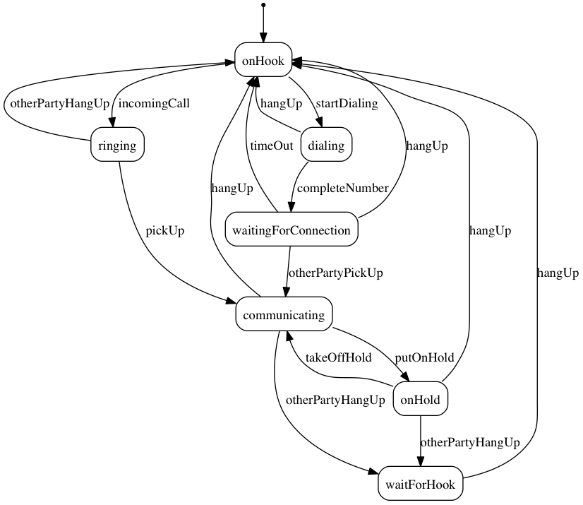
State Machine for a Phone Line

Slide 22
Umple for the Phone Line example
class phone {
state {
onHook {
startDialing -> dialling;
incomingCall -> ringing;
}
ringing {
pickUp -> communicating;
otherPartyHangUp -> onHook;
}
communicating {
hangUp -> onHook;
otherPartyHangUp -> waitForHook;
putOnHold -> onHold;
}
onHold {
hangUp -> onHook;
otherPartyHangUp -> waitForHook;
takeOffHold -> communicating;
}
dialing {
completeNumber -> waitingForConnection;
hangUp -> onHook;
}
waitingForConnection {
otherPartyPickUp -> communicating;
hangUp -> onHook;
timeOut -> onHook;
}
waitForHook {
hangUp -> onHook;
}
}
}

Slide 23
In-Class Modeling Exercise
Microwave oven system state machine
Events include buttons, door opening, door closing, timer ending, etc.

Slide 24
Homework
System for negotiating – major work task for after lecture 2
This system is to be used by negotiators, and mediators who are negotiating contracts.
A contract has a list of sections, each with a number, e.g. 1. A section has a list of clauses, each with a second-level number, e.g. 2.4 A clause may have sub-clauses (and possibly even sub-sub- clauses) which may have numbers or letters too. We will call sections, clauses, and sub- clauses ‘items’. An item may have a title and always has some text..
Negotiation is done in a series of ‘rounds’ each of which has a start date and time. The groups negotiating are called ‘parties’. There are always two parties.
At each round, each party may present some or all of the following
Propose a set of changes (including re-proposing changes that were rejected/withdrawn)
Agree to some set of changes that were previously proposed by the other party
Reject some set of changes that were previously proposed by the other party
Withdraw their own previous proposed changes that have not yet been accepted

Slide 25
Negotiating System - 2
A change may be
A modification to an item
Adding a new item. If a new item is proposed to be added it must be proposed to be inserted after a specific existing item, or as a subitem of an existing item, otherwise it goes at the end.
Deleting an existing item.
Negotiations go through the following states:
They are ‘initiated’ when there is agreement to negotiate and the names of the people doing negotiating are entered in the system.
Negotiations are ‘underway’ when there are outstanding proposals that remain ‘proposed’ (have not been ‘accepted’ or ‘withdrawn’).
Negotiations reach ‘stalemate’ when there is no difference made after a negotiating round, or all proposals are ‘rejected’.
Negotiations are ‘complete’ when all proposals are either ‘accepted’ or ‘withdrawn’ (i.e. there are no outstanding ‘rejected’ or ‘proposed’ changes).

Slide 26
Negotiating System - 3
A simple text reader can be used to read in the input.
E.g. To propose adding a first item at the beginning
P 0 First item
The system would return a change id that could be used later for agreeing, rejecting and withdrawing
-> C1
To agree to C!
A C1
To display the current agreed contract
D
To display the current proposed changes
C
Extension to the system: A meditator can also ‘propose’ changes or ‘withdraw’ their own proposed changes. A change proposed by a mediator must be accepted by both parties to be fully ‘accepted’.

Slide 27
How to Submit Your Negotiating System
Add any necessary extra requirements or assumptions and document them as a text file
Write the Umple code and compile it
  Get it to compile cleanly even if it doesn’t fully run
  Get as far as you can
  Put your name on files (as code comments)
Generate a graphviz class and state diagram and save as files too
Create a zip file with: Umple code + diagrams + text file
Submit to the following link: http://bit.ly/2qqUYyK or
https://www.dropbox.com/request/8cufWRaHStMjKWVQr6LV

Slide 28
Do Activities and Concurrency
A do activity executes
  In a separate thread
  Until
    Its method terminates, or
    The state needs to exit (killing the tread)
Example uses:
  Outputting a stream (e.g. playing music)
  Monitoring something
  Running a motor while in the state
  Achieving concurrency, using multiple do activities

Slide 29
Active Objects
These start in a separate thread as they are instantiated.
Declared with the keyword
active

Slide 30
Default Threading in State Machines
As discussed so far, code generated for state machines has the following behaviour:
  A single thread:
    Calls an event
    Executes the event (running any actions)
    Returns to the caller and continues
This has two problems:
If another thread calls the event at the same time they will ‘interfere’
There can be deadlocks if an action itself triggers an event

Slide 31
Queued State Machines
Solve the threading problem:
  Callers can add events to a queue without blocking
  A separate thread takes items off the queue ‘as fast as it can’ and processes them
Umple syntax: queued before the state machine declaration
We will look at examples in the manual

Slide 32
The Course Continues in Part 3
We will look at
  More advanced associations
  Separation of concerns using mixins, aspects and traits
  Generation of text using templates
  Nested state machines
  Auto and timed transitions
  Events with parameters
  State tables and simulations
  Pooling and queuing
  State machines in traits
Database and Formal method generation
Umple in Itself

