Slide 1
Teaching Effective UML Modeling by Combining it with Programming
6th Kinneret Conference on Software Engineering Education
February 19, 2018
Timothy C. Lethbridge, P.Eng.
University of Ottawa, Canada
tcl@eecs.uottawa.ca
http://www.umple.org

Slide 2
Context
Students have learned a little programming in a first course (or two)
Now it is time for them to start to build somewhat larger systems …
… so we teach them modeling and perhaps a little process
The traditional approach to teaching modeling (generally in UML) is:
Draw diagrams
Hand-wave about the semantics of the diagrams
Perhaps get students to write code that might correspond to the diagrams

Slide 3
My vision for student learning outcomes in second-year or third-year software courses
Concurrently they should learn to be able to
Analyse and design using high level abstractions
Model-driven development (MDD)
Develop in an agile manner
Responsiveness to users
Small iterations
Test-driven development (TDD)
Continue to develop programming skills
But generate code from models where possible
Use simple, but effective tools for the above

Slide 4
Lessons learned from years of teaching modeling in UML
Students (and practitioners) rarely develop the skills to be good UML modelers using traditional approaches
They have many patterns of misconception about semantics and pragmatics of modeling
This slows down software development later in industry
I learned how to teach modeling through trial and error (1990-2004+)
It required slow ‘board work’ to walk through many examples
To truly understand modeling, students needed to see resulting code, but code generators were dreadful
I needed a faster and more usable tool

Slide 5
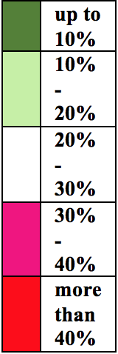
2017 modeling tool survey Perceived biggest drawbacks of top 7 tools

Slide 6
What is model-driven development (MDD)?
Developing software starting with high-level abstractions that can be visualized in diagram form
But diagrams are not essential!
The model can be written textually, and the diagrams generated

Slide 7
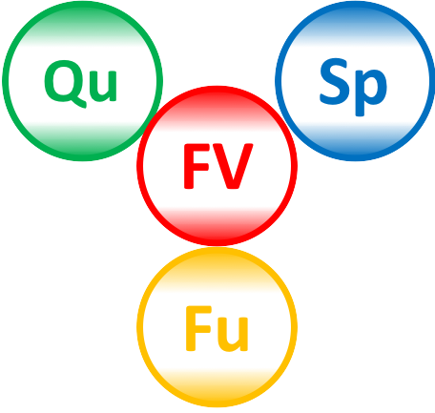
What are agile methods?
Developing very small changes to software, and releasing frequently, while responding to stakeholder needs, maintaining high quality and keeping overhead and technical debt low
It’s about balancing
Speed/Velocity (dates for delivery)
Functionality
Quality
Financial viability
Adjust 1 and 2, avoiding risks from sacrificing 3 and 4

Slide 8
Primary motivation for developing Umple
To create a tool with the best combination of features:
Textual model editing and blending with other languages
Ability to use in an agile process
Write tests, continuous integration, versioning
Combine the best of agility and modeling
Excellent code generation
Complete generation of real systems (including itself)
Multi-platform (command-line, Eclipse, Web)
Practical and easy to use for developers
Including great documentation
Open source

Slide 9
Other motivations for creating Umple
To be a real software system to which students can contribute as part of their software engineering education
It has been developed by about 60 students over 11 years
6 PhD, 4 masters
50 4th year undergraduates from 15 universities in their capstone projects
They deepen their understanding of many areas of CS and SE
To serve as a research platform for MDD, agile methods, tool usability, and so on

Slide 10
Umple: Simple, Ample, UML Programming Language
1. Textual modelling tool set
Command line compiler
Web-based tool (UmpleOnline) for demos and education
Eclipse plugin
2. Open source code generator for UML ++
Infinitely nested state machines, with concurrency
Proper referential integrity and multiplicity constraints on associations
Traits, mixins, aspects for modularity
Text generation templates, patterns, traits
3. Pre-processor to add UML, patterns and other features on top of Java, PhP, C++ and other languages

Slide 11
Overview and demo of Umple: www.umple.org
Online tool (Umpleonline at try.umple.org )
Manual: http://manual.umple.org
Open source on Github: http://code.umple.org

Slide 12
Example of textual Umple
We will visualize the following in UmpleOnline, then edit the diagram and see the text changing
class Student {
Integer id;
status {
entered { register -> registered; }
registered { pay -> paid; }
paid {}
}
}
class CourseSection
{
description;
1 -- * Student registrants;
}

Slide 13
My Classroom Technique When teaching UML modeling now I have Umple
50% PowerPoint Slides (as designed for my book)
25% Whiteboard work
25% UmpleOnline

Slide 14
Educational and industrial use of Umple
Used by me for teaching in
Second year Introduction to Software Engineering
Fourth year Advanced Design
Used by other professors in several universities
UmpleOnline usage as of February 2018 is about 10,000 transactions per day
Umple is written in itself – developed by students https://github.com/umple/umple/tree/master/cruise.umple/src
http://metamodel.umple.org
Umple is also used in some small companies

Slide 15
Key benefits from classroom use of Umple
Faster and easier than using the black/white board for UML modeling
Textual mode twice as fast as board
Graphical editor 25% faster than board
Ability to load saved designs to edit
Easier to rearrange design
Can explore design alternatives then save them for later
Ability to umplify, i.e. convert Java code to a model
Ability to generate good-quality code for discussion
Low footprint: Only requires a browser
Although Eclipse and command line can be used

Slide 16
Sample student exercises using Umple
Steps we might ask students to follow:
Enter a model graphically and/or textually
Generate code
Explain the semantics of UML by studying generated code
Then
Enter another model
Write a main program and test the generated code

Slide 17
Student satisfaction survey
In a 68-student 2nd year course Introduction to Software Engineering
10 Likert-scale questions
Took five minutes
Voluntary: 30 students participated
Just before start of class
On the next two slides, error bars indicate standard deviation

Slide 18
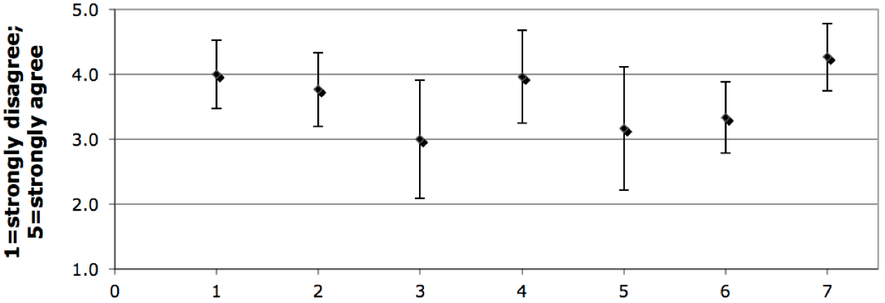
Results of survey
Umple in the lab helped
me understand concepts
Prof. Lethbridge should use it in future courses
Other tools would have been just as effective
Umple in the classroom
helped me understand concepts
I will get better grades
because of Umple
As of Dec 2010, Umple is too incomplete or buggy
I would use Umple in the future, assuming bugs fixed

Slide 19
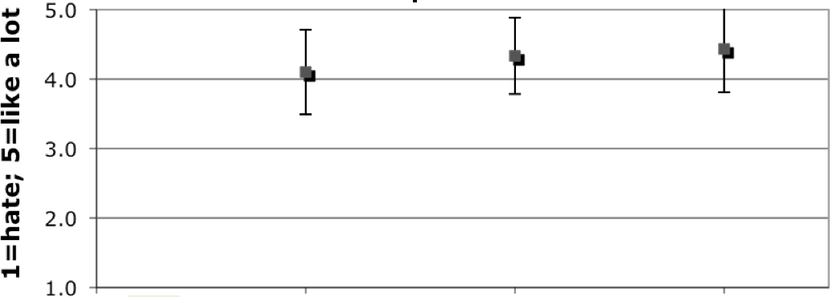
Ability to generate code to represent the model
Availability of a textual form for models and diagrams
Ability to edit diagram or text & have the other reflect changes

Slide 20
Comparison of grades
Comparison of 4 offerings of the same course before introducing Umple, and 2 offerings afterwards
Midterm examination grades on UML modeling question rose from 75.8% to 82.3%
8.6% improvement
Final exam grades on UML modeling questions rose from 76.4% to 83.6%
9.4% improvement
Highly statistically significant p<0.00002 on T Test
n=332 prior to Umple; n=137 afterwards
Similar results in 4th year course SEG4110
No difference in non-UML questions

Slide 21
Using the Umple project to teach the entire software lifecycle
Illustration of several aspects of industrial development online
Continuous Integration: http://travis.umple.org and http://cc.umple.org
Testing: http://qa.umple.org
Documentation: http://Javadoc.umple.org and http://manual.umple.org

Slide 22
Conclusions (1)
To help students better understand modeling concepts, I highly recommend:
Live modeling in the classroom with an easy-to-use web-based modeling tool such as UmpleOnline
Showing the results of good code generation so students understand the consequences of modeling decisions
Teach agile development of small complete systems using MDD+TDD

Slide 23
Conclusions (2)
Umple has been designed with the above goals in mind
Simple web interface + command-line + Eclipse
Text-based and graphical modeling in UML
State-of-the-art, but easy-to-understand generated code for class and state diagrams

Slide 24
Thank-you Any more questions?

Slide 25
Umple philosophy 1-4
P1. Modeling is programming and vice versa
P2. An Umple programmer should never need to edit generated code to accomplish any task.
P3. The Umple compiler can accept and generate code that uses nothing but UML abstractions.
The above is the inverse of the following
P4. A program without Umple features can be compiled by an Umple compiler.
e.g. input Java results in the same as output

Slide 26
Umple philosophy 5-8
P5. A programmer can incrementally add Umple features to an existing program
Umplification
P6. Umple extends the base language in a minimally invasive and safe way.
P7. Umple features can be created and viewed diagrammatically or textually
P8. Umple goes beyond UML

