Slide 1
Practical Model-Based Programming:
When Agile and Modeling Meet
February 2018
Timothy C. Lethbridge, I.S.P, P.Eng.
University of Ottawa, Canada
tcl@eecs.uottawa.ca
http://www.umple.org

Slide 2
Outline (timing flexible – depends on your background)
Introduction: Who am I and who are you?
Overview of Agility
Overview of Model-Driven Development
    Languages / Tools / Motivation for Umple
Agile Class Modeling
    Tools / Attributes / Methods / Associations / Exercises / Patterns
Agile Modeling with State Machines
    Basics / Concurrency / Case study and exercises
Separation of Concerns in Models
    Mixins / Aspects / Traits
More Case Studies and Hands-on Exercises
    Umple in itself / Real-Time / Data Oriented
Conclusion

Slide 3
Tell me briefly about you !
What software engineering processes do you use?
  Any agile experience?
  Automated testing??
  Continuous integration?
Modeling experience
  UML? Other language?
  Modeling tool?
What programming languages do you use?

Slide 4
My background
1986 First taught programing at a University
1987-89 Software developer Bell-Northern Research
1991-94 Taught software engineering part time
1994- Professor of software engineering at University of Ottawa
  Research focuses:
    Software engineering tools (Umple since 2007)
    Empirical studies
  Book: Object-Oriented Software Engineering
    McGraw-Hill
Research collaboration: IBM, Ericsson, General Motors, Mitel, Canadian Defense Department

Slide 5
Learning outcomes: You will be able to
  Understand model-driven and agile development.
  Using Umple, develop UML diagrams that can be integrated with code.
  Build systems that include models combined with code.
  Analyse models to find defects.
  Convert existing Java code to use Umple, reducing its code volume, and increasing its maintainability.
  Combine model-driven development with agile practices

Slide 6
Outline
Introduction: Who am I and who are you?
Overview of Agility
Overview of Model-Driven Development
    Languages / Tools / Motivation for Umple
Agile Class Modeling
    Tools / Attributes / Methods / Associations / Exercises / Patterns
Agile Modeling with State Machines
    Basics / Concurrency / Case study and exercises
Separation of Concerns in Models
    Mixins / Aspects / Traits
More Case Studies and Hands-on Exercises
    Umple in itself / Real-Time / Data Oriented
Conclusion

Slide 7
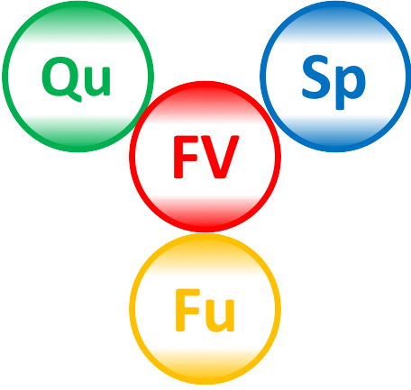
What are agile methods?
Developing very small changes to software, and releasing frequently, while responding to stakeholder needs, maintaining high quality and keeping overhead and technical debt low
It’s about balancing
  Speed/Velocity (dates for delivery)
  Functionality
  Quality
  Financial viability
Adjust 1 and 2, avoiding risks from sacrificing 3 and 4

Slide 8




So why be agile? It …
  Delivers core stakeholder value earlier
  Enables better quality of life by reducing stress and overtime
  Better manages stakeholder needs, which change and are usually not fully knowable
  Allows teams to build quality into projects without being held to ransom by unreasonable delivery requirements
  Keeps costs under control
  Lets the project fail fast if going in the wrong direction
“Waterfall” doesn’t work anywhere near as well for most projects

Slide 9
How to be agile (1)
Plan small releases (based on issue tracking and ‘sprints’).
  Or even better, Continuous Integration (CI)
Deliver automated tests with all code
  Run every time anyone builds
  Even better: Test-Driven Development
Design, document and manage with low overhead
  Collaborative design with wikis and issue comments
  Generate documentation from code and code comments

Slide 10
How to be agile (2) Red items are focus today
Automate, automate, automate
  Tools for
    Version control
    Continuous integration
    Design
    Code generation
    Testing
    Code analysis (metrics, defect finding)
    Documentation generation
    Code review
    Release/distribution
    Managing dependencies

Slide 11
How to be agile (3)
Involvement of and responsiveness to end-users
  Understand and respond to their needs
  Have them ‘in house’ to
    Discuss plans, designs
    Try out prototypes
  Get working software into their hands fast

Slide 12
Any drawbacks to being agile (1)?
Tricky if you are given a binder of pre-written requirements
  Solutions:
    Negotiate to be agile
    Decline to accept a contract for unchangeable requirements

Slide 13
Any drawbacks to being agile (2)?
For much embedded software:
  Safety and security are not-negotiable requirements
  Hard to repeatedly change in the field
For software with many or complex interfaces to other software or hardware
  Specification of interfaces up-front allows co-engineering and avoids chaos
But for both of the above
  Exploratory and prototype development can still be agile
  Use simulators/stubs/wrappers/abstraction layers for other hardware and software

Slide 14
More details about some agile techniques …

Slide 15
Agility details:
Test driven development (TDD)
Tests are the specification of what code should do.
Process
  Write the test
  Verify it fails
  Design and modify the code
  Verify the test passes
  Do other refactoring or changes as needed
  Always verify the test keeps passing

Slide 16
Agility details:
Continuous integration (CI)
Integrate agile increments into customer-facing code as soon as they are ready (maybe many times a day!)
  ‘Ready’ means checks have passed such as:
    100% test pass
    Code review
    On-site user review
    Code analysis for vulnerabilities etc.
Options:
  Slow releases as well as continuous releases
  A/B testing – some users given experimental version

Slide 17
Agility details:
Curation of issues / backlog
Bugs, features, enhancements are all issues
Can come from end-users, customers, marketing staff, developers
  Developer issues might include refactoring and dealing with technical debt
There is a need to work on the highest-value issues first
  Both bugs and enhancements
  Not do ‘too much’
  Regular sorting ‘planning game’ needed

Slide 18
Agility details:
Planned reduction of technical debt (discuss if time)
Technical Debt (TD)
  = required future development needed to avoid excess costs (interest) from software evolution and support
Examples
  Inflexible/non-scalable design choices
  “quick and dirty” implementation
  Poor code: Spaghetti, “God” classes
  The need to upgrade obsolescent dependencies
Agility helps manages TD
  By allowing scheduling of regular refactoring activities

Slide 19
Other agile practices
Pair programming
  Can be useful but not essential
  Can improve quality especially when new team members are dealing with complex problems
  But there is a tipping point where productivity is negatively impacted
Stand-up meetings
  Help avoid overhead

Slide 20
Key tools to facilitate agility
Git and environments like Github/Gitlab/Bitbucket
  Versioning, branching, merging of textual code
Issue trackers, including those integrated with the above
Wiki document editing tools
Continuous Integration Tools
  E.g. Travis / Appeyor
Using heavyweight tools – can break agility

Slide 21
Outline
Introduction: Who am I and who are you?
Overview of Agility
Overview of Model-Driven Development
    Languages / Tools / Motivation for Umple
Agile Class Modeling
    Tools / Attributes / Methods / Associations / Exercises / Patterns
Agile Modeling with State Machines
    Basics / Concurrency / Case study and exercises
Separation of Concerns in Models
    Mixins / Aspects / Traits
More Case Studies and Hands-on Exercises
    Umple in itself / Real-Time / Data Oriented
Conclusion

Slide 22
What is model-driven development (MDD)?
Developing software starting with high-level abstractions that can be visualized in diagram form
But diagrams are not essential!
  The model can be written textually, and the diagrams generated

Slide 23
MDD languages …

Slide 24
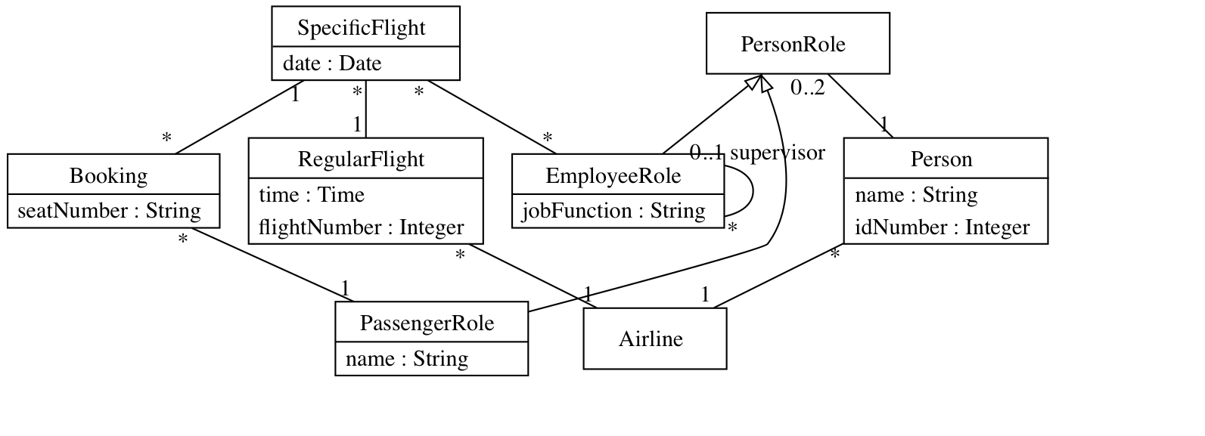
Some high-level abstractions used in MDD:
UML class diagrams
  Show classes, attributes, generalizations and interrelationships among data (associations) in ways hard to see by just looking at code
  Code at: http://try.umple.org/?example=Airline&diagramtype=GvClass

Slide 25
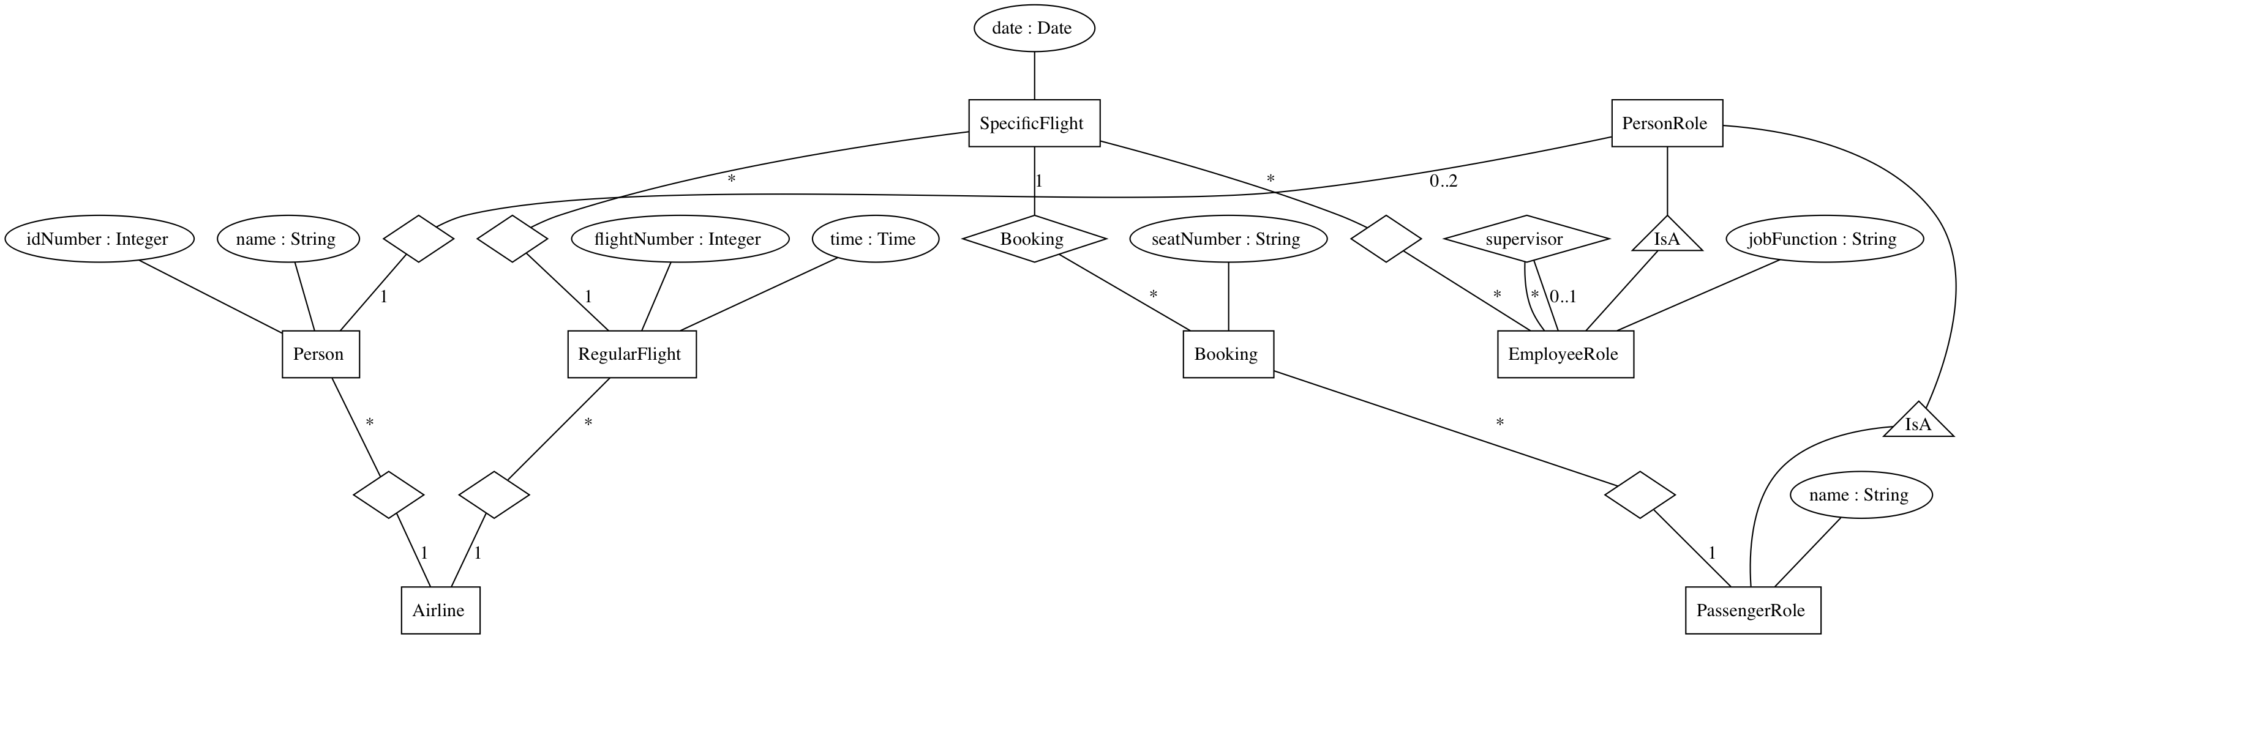
Some high-level abstractions used in MDD:
Entity-Relationship Diagrams (ERD)
For many purposes, interchangeable with class diagrams
  Used heavily in database community (Not UML)

Slide 26
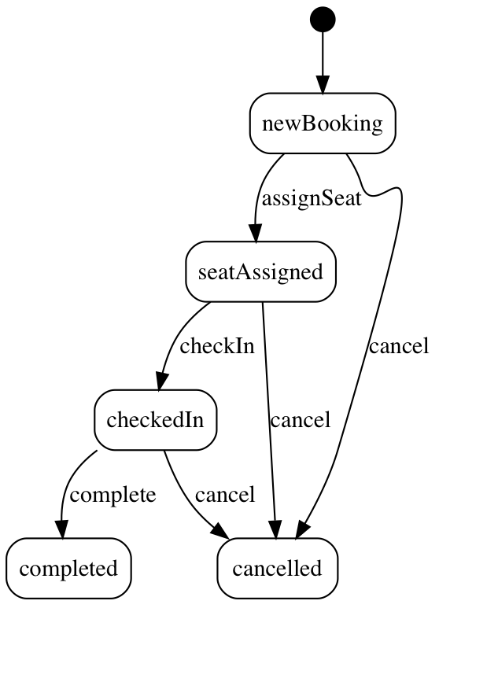
Some high-level abstractions used in MDD: State Machines
  Show behaviour
  Behaviour changes in response to events

Slide 27
Benefits of visual modeling languages
2-D, with lines and symbols, allows for
  Greater information density
  Greater and different abstractions
Facilitates communication
  With stakeholders
  About issues not obvious in code
Developers notice different information from what they would see in code
  Helps detect bugs

Slide 28
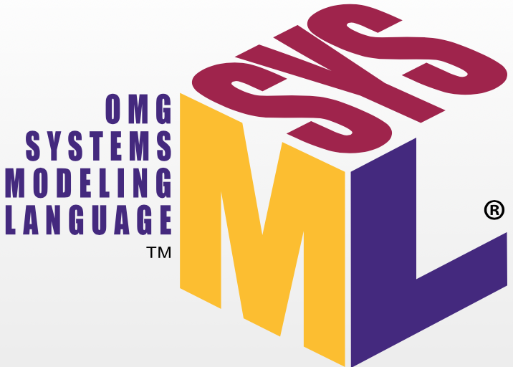
Key MDD languages: UML, SysML,
Both promoted by the Object Management Group
UML
  Original focus: object-oriented software
  Studies show it is widely taught but mostly used informally
  Most developers has some familiarity, but don’t use it much
  Considerable uptake in telecom, automotive domains
SysML
  Focus on systems including hardware

Slide 29
Other MDD technologies (language+tool):
Simulink and Stateflow
Part of MathWorks’ MATLAB suite
  Widely used in automotive and other safety-critical domains
  But expensive and not taught much to general software engineers

Slide 30
Variants of MDD:
Processes and architectures
Model-Driven Architecture™
  An OMG standard focusing on separation of modeling concerns, layers of models
  Platform independent vs platform-specific modeling
  http://www.omg.org/mda/
Near synonyms of MDD
  Model-Driven Design
  Model-Driven Engineering

Slide 31
MDD tools …

Slide 32
Sample UML modeling tools in wide use
  Papyrus, and other Eclipse-based tools
    Open source leaders
  IBM Rhapsody, current most widely used IBM tool
  ArgoUML
    Developed 1999-2011, but not maintained
  Astah
  Magic Draw
  StarUML
  PlantUML
  Visual Paradigm
For more details and links see
https://en.wikipedia.org/wiki/List_of_Unified_Modeling_Language_tools

Slide 33
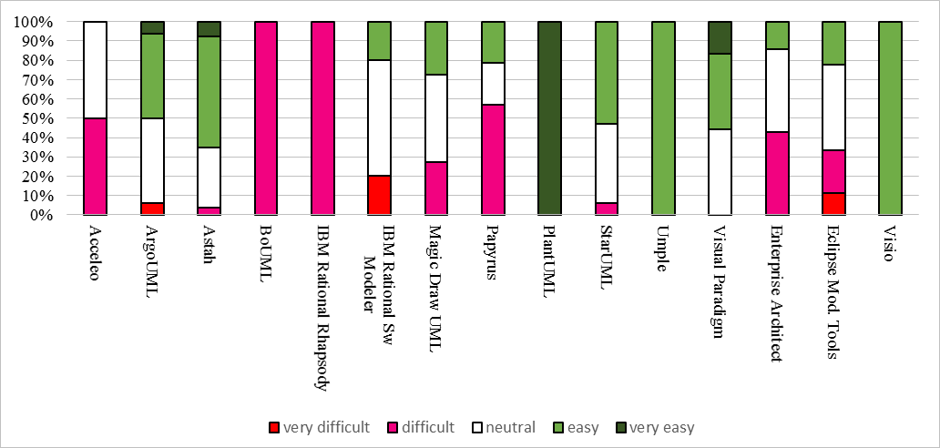
Difficulty level of top 15 modeling tools in a survey of professors my team conducted (early 2017)

Slide 34
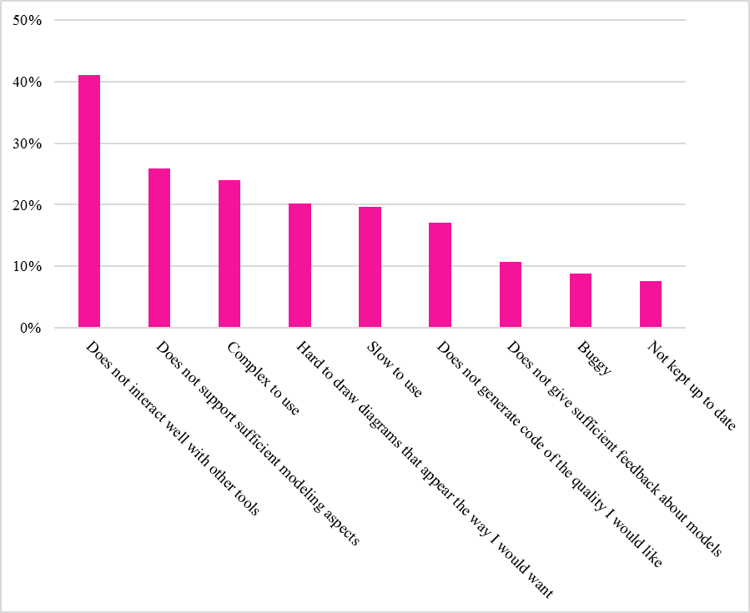
Biggest perceived drawbacks of all modeling tools

Slide 35
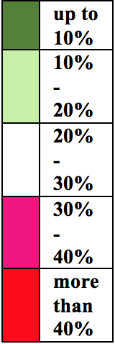
Perceived biggest drawbacks of top 7 tools

Slide 36
Textual modeling, and motivation for Umple …

Slide 37
Textual modeling tools
Almost all tools support a way to exchange models textually: XMI (XML Metadata Interchange)
  But not intended or easy for human editing
Some tools are specifically designed to allow modeling textually in the same way one would program
  Many examples:
    List at https://modeling-languages.com/text-uml-tools-complete-list/
    PlantUML: https://www.planttext.com
      Nice, but lacks features such as complete code generation
    Others: USE, TextUML, yUML

Slide 38
Umple: Simple, Ample,
UML Programming Language
1. Open source textual modelling tool set for 3 platforms
  Command line compiler
  Web-based tool (UmpleOnline) for demos and education
  Eclipse plugin
2. Code generator for UML ++
  Infinitely nested state machines, with concurrency
  Proper referential integrity and multiplicity constraints on associations
  Traits, mixins, aspects for modularity
  Text generation templates, patterns, traits
3. Pre-processor to add UML, patterns and other features on top of Java, PhP, C++ and other languages

Slide 39
Websites
Entry-point: http://umple.org
UmpleOnline: http://manual.umple.org
Github: https://github.com/umple/umple
These slides are available
  http://www.site.uottawa.ca/~tcl/tmp/ILTAMLethbridge.pptx

Slide 40
Motivation for developing Umple (1)
We want the best combination of features:
  Textual editing and blending with other languages
  Ability to use in an agile process
    Write tests, continuous integration, versioning
    Combine the best of agility and modeling
  Excellent code generation
    Complete generation of real systems (including itself)
  Multi-platform (command line, Eclipse, Web)
  Practical and easy to use for developers
    Including great documentation
  Open source

Slide 41
Motivation for developing Umple (2)
Many existing tools:
  Lacked in usability
    Awkward to edit diagrams
    Many steps to do a task
    Lengthy learning process
  Lack in ongoing support
  Could be enhanced byus perhaps, but we would be tied to key decisions (e.g. Eclipse-only)

Slide 42
Some key Umple innovations
Model is code
  Traditional code is embedded in model
No need to edit generated code
  No ‘round-trip engineering’

Slide 43
What technology might you need for exercises (1)?
For full capabilities to do hands-on exercises
  A computer (laptop) with Java 8 or 9 JDK
  Mac and Linux are the easiest platforms, but Windows works also can be used
Alternatively, a tablet (e.g. iPad) can be used for many tasks
  The larger the screen, the easier

Slide 44
What technology might you need for exercises (2)?
We will mostly be using
  Umpleonline
    In a web browser: http://try.umple.org
    Or in Docker: http://docker.umple.org
  Umple on the command line: http://dl.umple.org
    Needs Java 8 JDK on the command line: http://bit.ly/1lO1FSV
      Java 9 works well too
Optional:
  Umple in Eclipse https://github.com/umple/umple/wiki/InstallEclipsePlugin
  cmake and gcc for compiling C++ code

Slide 45
Outline
Introduction: Who am I and who are you?
Overview of Agility
Overview of Model-Driven Development
    Languages / Tools / Motivation for Umple
Agile Class Modeling
    Tools / Attributes / Methods / Associations / Exercises / Patterns
Agile Modeling with State Machines
    Basics / Concurrency / Case study and exercises
Separation of Concerns in Models
    Mixins / Aspects / Traits
More Case Studies and Hands-on Exercises
    Umple in itself / Real-Time / Data Oriented
Conclusion

Slide 46
Umple class models – quick overview
Key elements:
  Classes
  Attributes
  Associations
  Generalizations
  Methods
We will look at all these using examples
Umple code/models are stored in files with suffix .ump

Slide 47
Exercise: Compiling and changing a model
Look at the example at the bottom of http://helloworld.umple.org (also on next slide)
  Observe: attribute, association, class hierarchy, mixin
Click on Load the above code into UmpleOnline
  Observe and modify the diagram
  Add an attribute
  Make a multiplicity error, then undo
  Generate code and take a look
  Download, compile and run if you want

Slide 48
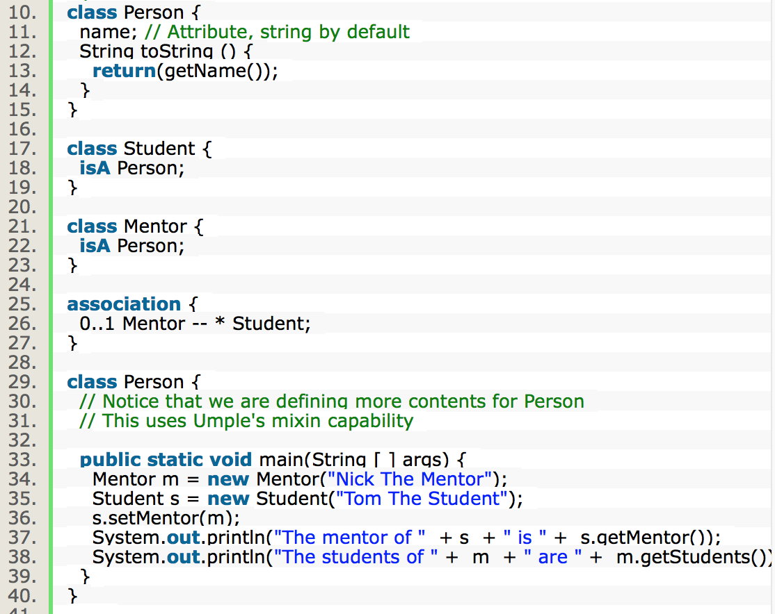
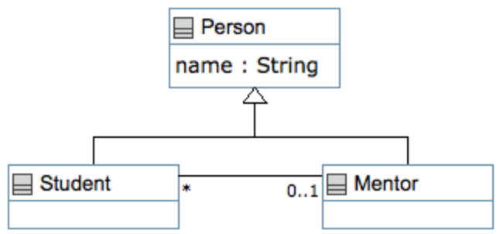
Hello World Example 2 in the User Manual

Slide 49
Key tools:
UmpleOnline, command line, user manual

Slide 50
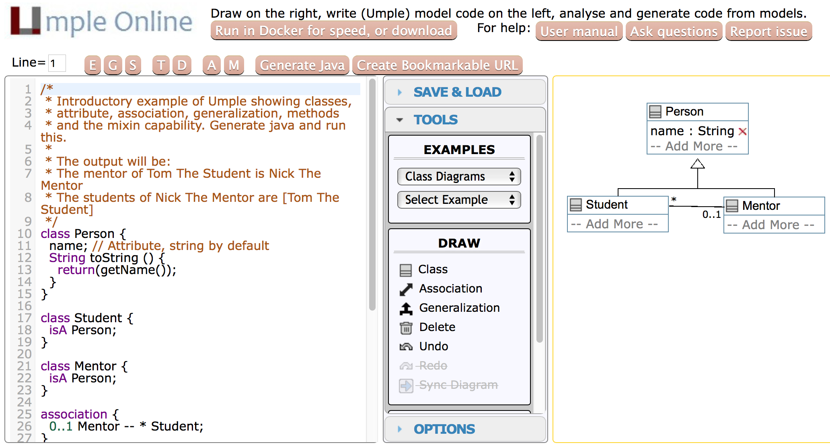
Hello World example 2 in UmpleOnline

Slide 51
Exploration of UmpleOnline
Explore class diagram examples
Options
  T or Control-t (hide and show text)
  D or Control-d (hide and show diagram)
  A, M to hide and show attributes, methods
  Default diagram types
    G/Control-g (Graphviz), S/Control-s (State Diagram)
    E/Control-e (Editable class diagram)
Generate code and look at the results
  In Umple you never should modify generated code
  It is designed to be readable for educational purposes

Slide 52
Use of the UmpleOnline Docker image
Umple’s server can handle 80,000 transactions per hour
  Code generations, edits
But needs a good Internet connection
… and sometimes hundreds of students have assignments due!
To maximize speed of UmpleOnline run it in your local machine:
  Follow the instructions at http://docker.umple.org

Slide 53
Demo of compiling on the command line
To compile on the command line you will need Java 8
Download Umple from http://dl.umple.org
Basic compilation
  java -jar umple.jar model.ump
  java -jar umple.jar --help
To generate and compile the java to a final system
  java –jar umple.jar model.ump -c -

Slide 54
Quick walkthrough of the user manual
http://manual.umple.org
Note in particular
  Key sections: attributes, associations, state machines
  Grammar
  Generated API
  Errors and warnings
  Editing pages in github

Slide 55
Attributes

Slide 56
Attributes
“Instance variables”
  Part of the state of an object
  Simple data that will always be present in each instance
Specified like a Java or C++ field or member variable
But, intended to be more abstract!
Example, with an initial value
  a = "init value";

Slide 57
Code generation from attributes
Default code generation
  Generates a getName() and setName() method for name
    public
  Creates an arguments in the class constructor by default
  An attribute is private to the class by default
    Should only be accessed get, set methods

Slide 58
Umple builtin datatypes
String // (default if none specified)
Integer
Float
Double
Boolean
Time
Date
The above will generate appropriate code in Java, C++ etc.
  e.g. Integer becomes int
Other (native) types can be used but without guaranteed correctness

Slide 59
Attribute stereotypes (1)
Code generation can be controlled through stereotypes:
  lazy - don’t add a constructor argument
      lazy b; // sets it to null, 0, “” depending on type
  Defaulted – can be reset
      defaulted s = "def"; // resettable to the default

Slide 60
Attribute stereotypes (2)
  autounique – provide a unique value to each instance
      autounique x; // sets attribute to 1, 2, 3 …
  internal – don’t generate any methods
      internal i; // doesn’t generate any get/set either

Slide 61
Immutability
Useful for objects where you want to guarantee no possible change once created
  e.g. a geometric point
Generate a constructor argument and get method but no set method
immutable String str;
No constructor argument, but allows setting just once.
lazy immutable z;

Slide 62
Lets explore attributes by example
Go to
http://attributes.umple.org

Slide 63
Derived attributes
These generate a get method that is calculated.
class Point
{
// Cartesian coordinates
Float x;
Float y;
// Polar coordinates
Float rho =
{Math.sqrt(Math.pow(getX(), 2) + Math.pow(getY(), 2))}
Float theta =
{Math.toDegrees(Math.atan2(getY(),getX()))}
}

Slide 64
Multi-valued attributes
Limit their use. Associations are generally better.
class Office {
Integer number;
Phone[] installedTelephones;
}
class Phone {
String digits;
String callerID;
}

Slide 65
Keys
Enable Umple to generate an equals() and a hashcode() method
class Student {
Integer id;
name;
key { id }
}
The user manual has a sports team example showing keys on associations too
Note how this feature is not inherited from UML

Slide 66
Generalization and interfaces

Slide 67
Generalization in Umple
Umple uses the isA keyword to indicate generalization
class Shape {
colour;
}
class Rectangle {
isA Shape;
}

Slide 68
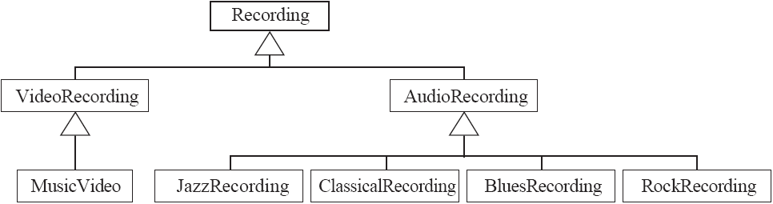
Avoiding unnecessary generalizations
Inappropriate hierarchy of
Classes
What should the model be?

Slide 69
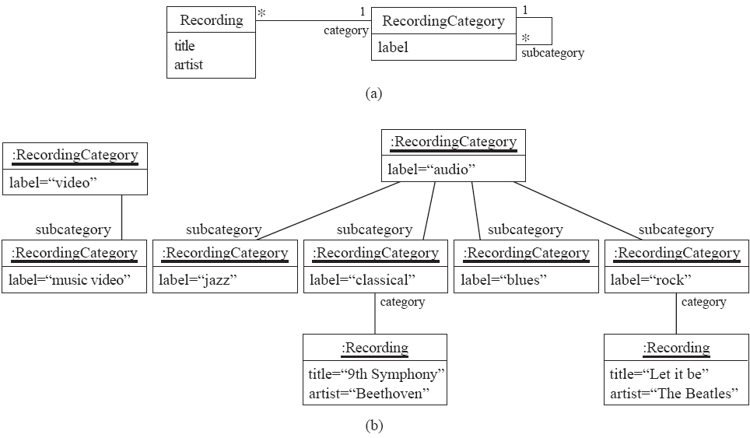
Avoiding unnecessary generalizations (cont)
Open in Umple
Improved class diagram, with its corresponding instance diagram

Slide 70
Interfaces
Declare signatures of a group of methods that must be implemented by various classes
Also declared using the keyword isA
Essentially the same concept as in Java
Let’s explore examples in the user manual …

Slide 71
Methods

Slide 72
User-written methods in umple
Methods can be added to any Umple code.
Umple parses the signature only; the rest is passed to the generated code.
You can specify different bodies in different languages
We will look at examples in the user manual …

Slide 73
Associations

Slide 74
Associations
Describe how instances of classes are linked at runtime
  Bidirectional -- or unidirectional ->
Multiplicity: Bounds on the number of linked instances
  * Or 0..* 0 or more
  1..* 1 or more
  1 Exactly 1
  2 Exactly 2
  1..3 Between 1 and 3
  0..2 Up to 2

Slide 75
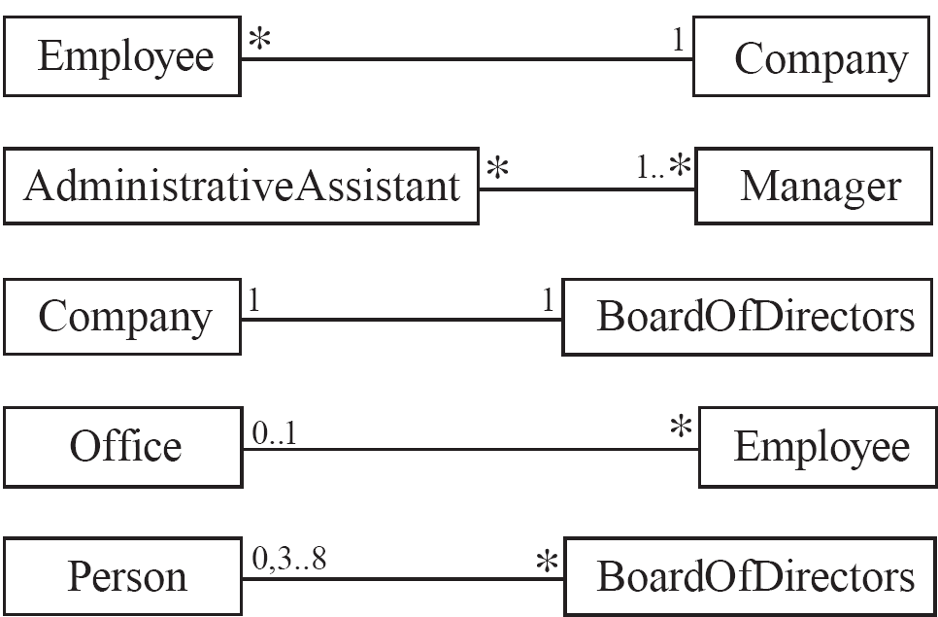
Basic UML associations

Slide 76
Many-to-one associations (1)
class Employee {
id;
firstName;
lastName;
}
class Company {
name;
1 -- * Employee;
}

Slide 77
Many-to-one associations (2)
  A company has many employees,
  An employee can only work for one company.
    This company will not store data about the moonlighting activities of employees!
  A company can have zero employees
    E.g. a ‘shell’ company
  It is not possible to be an employee unless you work for a company
  Let’s draw and write this in UmpleOnline:
Employee
*
1
Company

Slide 78
Referential integrity
When an instance on one side of the association changes
  The linked instances on the other side know …
  And vice-versa
This is standard in Umple associations, which are bidirectional

Slide 79
Role names (optional, in most cases)
Allow you to better label either end of an association
class Person{
id;
firstName;
lastName;
}
class Company {
name;
1 employer -- * Person employee;
}

Slide 80
Many-to-many associations
  An assistant can work for many managers
  A manager can have many assistants
  Assistants can work in pools working for several managers
  Managers can have a group of assistants
  Some managers might have zero assistants.
  Is it possible for an assistant to have, perhaps temporarily, zero managers?
*
1..*
*
*
*
*
Assistant
*
Manager
supervisor
Open in Umple

Slide 81
One-to-one associations (Use cautiously)
  For each company, there is exactly one board of directors
  A board is the board of only one company
  A company must always have a board
  A board must always be of some company
1
1
Open in Umple

Slide 82
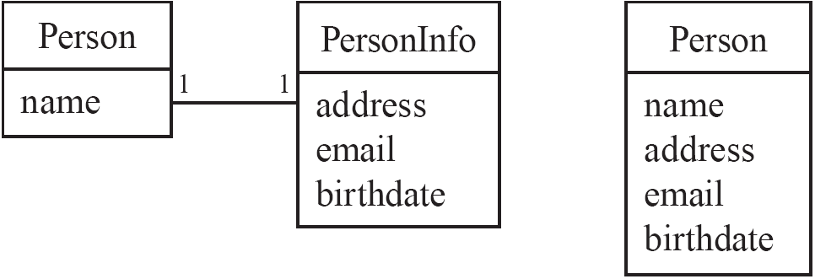
Typical erroneous use of one-to-one
Avoid this do this

Slide 83

Unidirectional associations
Associations are by default bi-directional
It is possible to limit the direction of an association by adding an arrow at one end
In the following unidirectional association
    A Day knows about its notes, but a Note does not know which Day is belongs to
    Note remains ‘uncoupled’ and can be used in other contexts
class Day {
* -> 1 Note;
}
class Note {}
Open in Umple

Slide 84

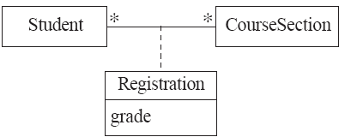
Association classes
Sometimes, an attribute that concerns two associated classes cannot be placed in either of the classes
The following are nearly equivalent
  The only difference:
    in the association class there can be only a single registration of a given Student in a CourseSection
Open in Umple and extended example

Slide 85
Association classes (cont.)
Umple code
class Student {}
class CourseSection {}
associationClass Registration {
* Student;
* CourseSection;
}
Open in UmpleOnline, and then generate code

Slide 86
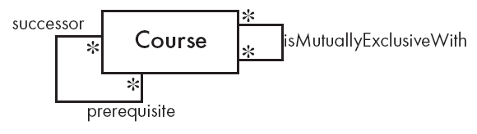
Reflexive associations
An association that connects a class to itself
class Course {
* self isMutuallyExclusiveWith; // Symmetric
}
association {
* Course successor -- * Course prerequisite;
}
Open in Umple

Slide 87
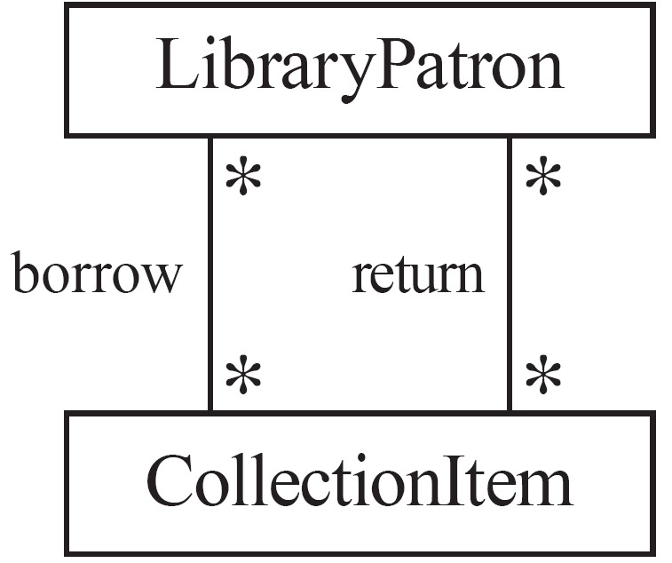
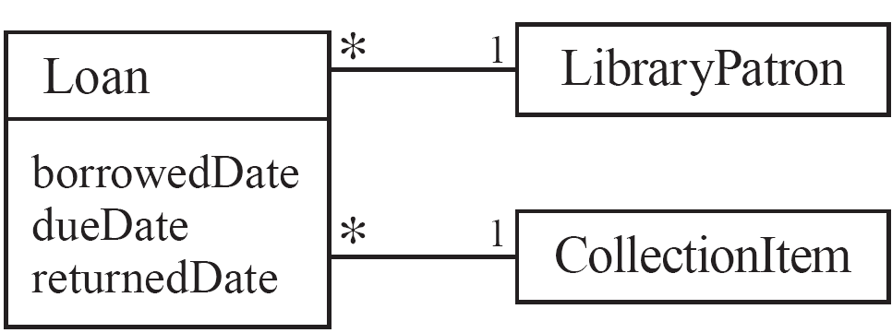
Actions versus associations
  A common mistake: to represent actions as if they were associations
Better: The
borrow
operation creates a
Loan
, and
Bad, due to the use of associations
the
return
operation sets the
returnedDate
that are actions
attribute.

Slide 88
Modeling hierarchies of instances
Either:
  Use a reflexive 1 -- * association
  Or use the composite pattern:
class Employee {
name;
}
class Manager {
isA Employee;
0..1 -- * Employee subordinate;
}
Class OrdinaryEmployee {
isA Employee;
}

Slide 89
Associations versus generalizations
Associations describe the relationships that will exist between instances at run time.
  When you show an instance diagram generated from a class diagram, there will be an instance of both classes joined by an association
Generalizations describe relationships between classes in class diagrams.
  They do not appear in instance diagrams at all.
  An instance of any class should also be considered to be an instance of each of that class’s superclasses

Slide 90
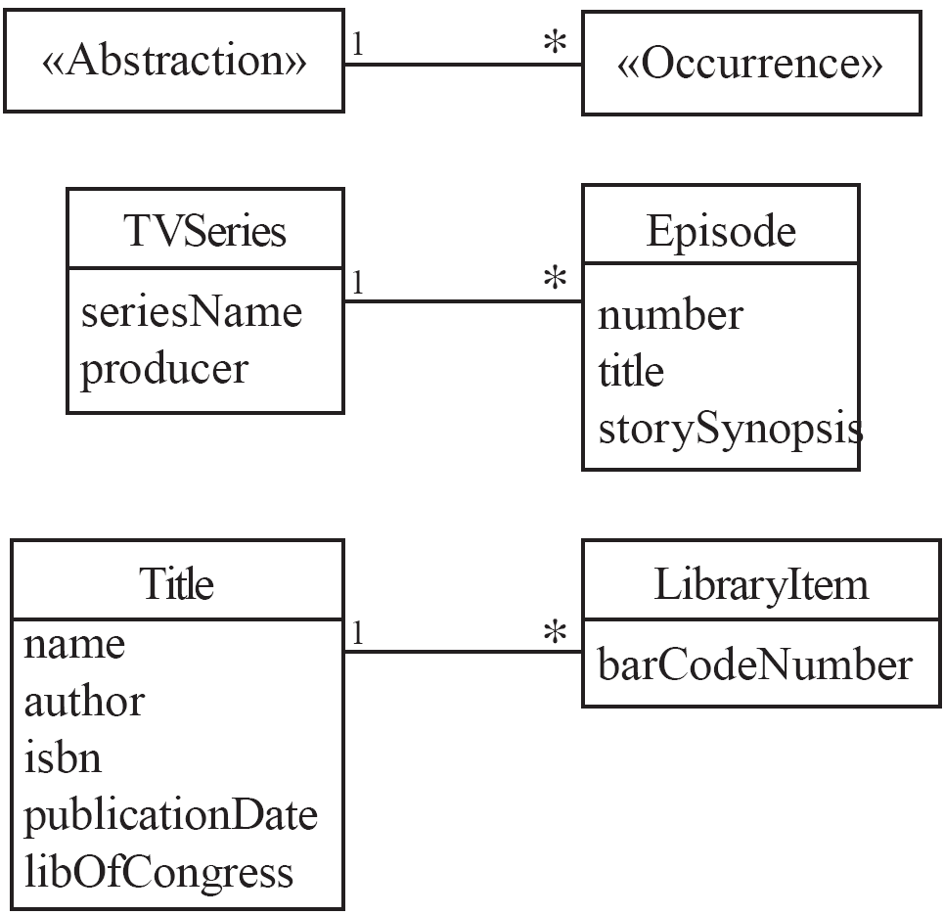
An important association pattern: Abstraction-Occurrence

Slide 91
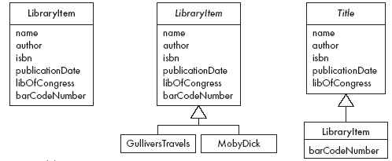
Antipatterns to Abstraction-Occurrence
Don’t do these!!

Slide 92
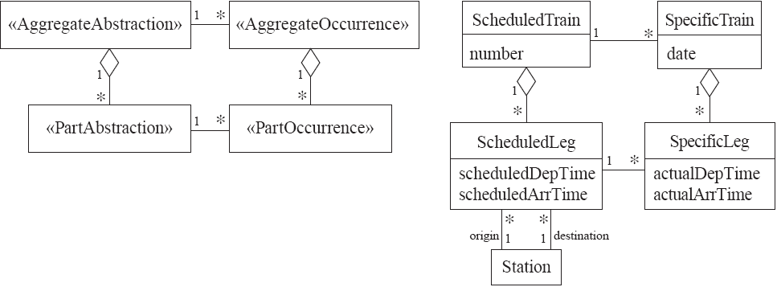
Square Abstraction-Occurrence
Try modeling these in Umple

Slide 93
Inline vs. standalone associations
The following are equivalent to allow flexibility:
class X {}
class Y {
1 -- * X;
}
---
class X {}
class Y {}
association {
1 Y -- * X;
}

Slide 94
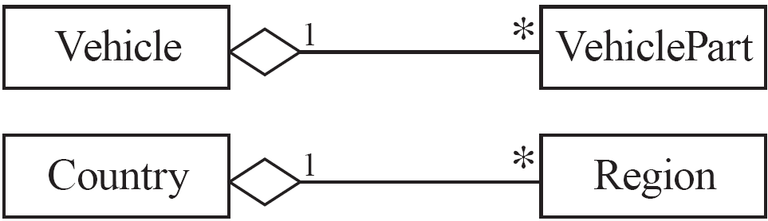
Aggregation
Aggregations are ordinary associations that represent part-whole relationships.
  The ‘whole’ side is often called the assembly or the aggregate
  This is a shorthand for association named isPartOf
  Umple has no special syntax currently
class Vehicle {
1 whole -- * VehiclePart part;
}
class VehiclePart{
}

Slide 95

Composition
A composition is a strong kind of aggregation
  If the aggregate is destroyed, then the parts are destroyed as well
class Building {
1 <@>- * Room;
}
class Room{
}

Slide 96
Sorted Associations
Order objects in the association according to a specific key
class Academy {
1 -- * Student registrants sorted {id};
}
class Student {
Integer id;
name;
}
We will look at a more complete example in the User Manual

Slide 97
A final word on associations
More help and examples are in the user manual online at
http://associations.umple.org

Slide 98
Modeling exercises

Slide 99
Modeling Exercises
Build a class diagram for the following. If you think there are key requirements missing, then add them.
1. A building can have many floors and several elevators. Each elevator serves a set of floors
2. A football (soccer) team has players. Each player plays a position. The team plays some games against other teams during each season. The system needs to record who scored goals, and the score of each game.

Slide 100
Another example (if there is time or interest)
Model the following in Umple:
A bus company has a set of busses of three different types.
Each type has a different capacity.
The company runs busses on various routes.
Each route stops at a set of stops.
Some routes run every n minutes from a start time to a stop time each day, other than holidays.
Other routes run at specific times.

Slide 101
Umple philosophy (if time)

Slide 102
Umple philosophy 1-4
P1. Modeling is programming and vice versa
P2. An Umple programmer should never need to edit generated code to accomplish any task.
P3. The Umple compiler can accept and generate code that uses nothing but UML abstractions.
      The above is the inverse of the following
P4. A program without Umple features can be compiled by an Umple compiler.
  e.g. input Java results in the same as output

Slide 103
Umple philosophy 5-8
P5. A programmer can incrementally add Umple features to an existing program
  Umplification
P6. Umple extends the base language in a minimally invasive and safe way.
P7. Umple features can be created and viewed diagrammatically or textually
P8. Umple goes beyond UML

Slide 104
Simple patterns (if time)

Slide 105
Singleton pattern
Standard pattern to enable only a single instance of a class to be created.
  private constructor
  getInstance() method
Declaring in Umple
class University {
singleton;
name;
}

Slide 106
Delegation pattern
A class calls a method in its ‘neighbour’
class RegularFlight {
flightNumber;
}
Class SpecificFlight {
* -- 1 RegularFlight;
flightNumber = {getRegularFlight().getFullNumber()}
}
Full details of this example in the user manual

Slide 107
Basic constraints
Shown in square brackets
  Code is added to the constructor and the set method
class X {
Integer i;
[! (i == 10)]
}
We will see constraints later in state machines

Slide 108
Converting requirements to models
(if time and/or interest)

Slide 109
Tips for building a model from requirements
  Identify a first set of candidate classes
  Focus on the core 1-2 classes
    Add associations and attributes
    Find generalizations and apply patterns as needed
    Iterate for the other classes
  Then work on methods
  Iterate until the model is satisfactory

Slide 110
Discovering classes in requirements
  Look at a source material such as a description of requirements
  Extract the nouns and noun phrases
  Eliminate nouns that:
    are redundant (same meaning)
    represent instances (e.g. specific people)
    are vague or highly general (e.g. ‘Object’)
    not needed in the application
  Pay attention to classes in a domain model that represent types of users or other actors
    They may or may not be needed

Slide 111
Identifying associations and attributes
  Start with classes you think are most central and important
  Decide on the clear and obvious data it must contain and its relationships to other classes.
  Work outwards towards the classes that are less important.
  Avoid adding too many associations and attributes to a class
    A system is simpler if it manipulates less information

Slide 112
Tips about identifying and specifying valid associations
  Specify the multiplicity at both ends
  Use role names if necessary

Slide 113
Outline
Introduction: Who am I and who are you?
Overview of Agility
Overview of Model-Driven Development
    Languages / Tools / Motivation for Umple
Agile Class Modeling
    Tools / Attributes / Methods / Associations / Exercises / Patterns
Agile Modeling with State Machines
    Basics / Concurrency / Case study and exercises
Separation of Concerns in Models
    Mixins / Aspects / Traits
More Case Studies and Hands-on Exercises
    Umple in itself / Real-Time / Data Oriented
Conclusion

Slide 114
Basic state machines

Slide 115
Basics of state machines
  At any given point in time, the system is in one state.
  It will remain in this state until an event occurs that causes it to change state.
  A state is represented by a rounded rectangle containing the name of the state.
  Special states:
    A black circle represents the start state
    A circle with a ring around it represents an end state

Slide 116
Garage door state machine
class GarageDoor{
status {
Open {
buttonOrObstacle -> Closing;
}
Closing {
buttonOrObstacle -> Opening;
reachBottom -> Closed;
}
Closed {
buttonOrObstacle -> Opening;
}
Opening {
buttonOrObstacle -> HalfOpen;
reachTop -> Open;
}
HalfOpen {
buttonOrObstacle -> Opening;
}
}
}

Slide 117
Events
An occurrence that may trigger a change of state
  Modeled in Umple as generated methods that can be called
Several states may be able to respond to the same event

Slide 118
Transitions
  A change of state in response to an event.
    It is considered to occur instantaneously.
  The label on each transition is the event that causes the change of state.

Slide 119
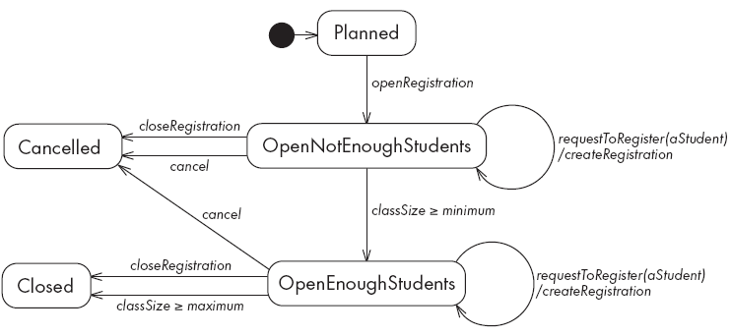
State diagrams – an example with conditional transitions

Slide 120
Actions in state diagrams
  An action is a block of code that must be executed effectively instantaneously
    When a particular transition is taken,
    Upon entry into a particular state, or
    Upon exit from a particular state
  An action should consume no noticeable amount of time

Slide 121
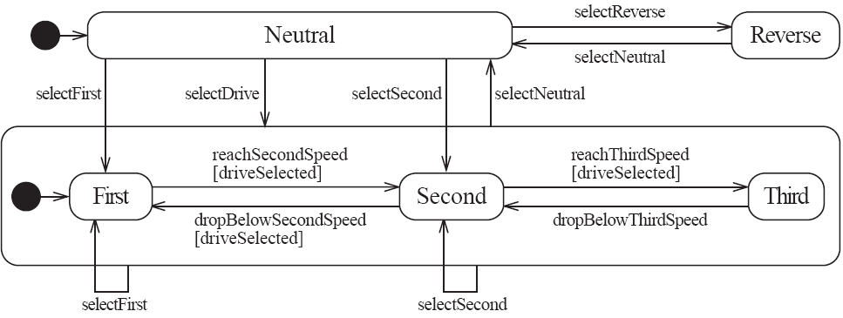
Nested substates and guard conditions
A state diagram can be nested inside a state.
  The states of the inner diagram are called substates.

Slide 122
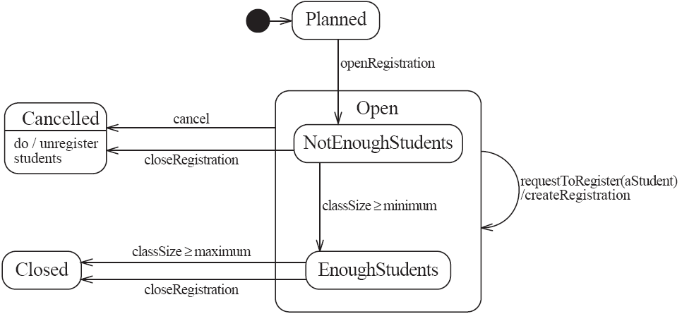
Nested state diagram – Another example

Slide 123
Auto-transitions
A transition taken immediately upon entry into a state
  Unless guarded
We will look at an example in the user manual

Slide 124
Events with parameters
Parameters can be referenced in guards and actions.
We will look at an example in the user manual.

Slide 125
Analysing models

Slide 126
Models can be analysed in several ways
Visually
Automatically generated errors and warnings
State tables (next slide)\
Metrics
Formal methods (nuXMV)

Slide 127
State tables and simulations
Allow analysis of state machines statically without having to write code
We will explore these in UmpleOnline by looking at state machine examples and generating tables and simulations

Slide 128
Concurrency

Slide 129
Do activities and concurrency
A do activity executes
  In a separate thread
  Until
    Its method terminates, or
    The state needs to exit (killing the tread)
Example uses:
  Outputting a stream (e.g. playing music)
  Monitoring something
  Running a motor while in the state
  Achieving concurrency, using multiple do activities

Slide 130
Active objects
These start in a separate thread as they are instantiated.
Declared with the keyword
active

Slide 131
Default threading in state machines
As discussed so far, code generated for state machines has the following behaviour:
  A single thread:
    Calls an event
    Executes the event (running any actions)
    Returns to the caller and continues
This has two problems:
If another thread calls the event at the same time they will ‘interfere’
There can be deadlocks if an action itself triggers an event

Slide 132
Queued state machines
Solve the threading problem:
  Callers can add events to a queue without blocking
  A separate thread takes items off the queue ‘as fast as it can’ and processes them
Umple syntax: queued before the state machine declaration
We will look at examples in the manual

Slide 133
Pooled state machines
Default Umple Behavior (including with queued):
  If an event is received but the system is not in a state that can handle it, then the event is ignored.
Alternative pooled stereotype:
  Uses a queue (see previous slide)
  Events that cannot be processed in the current state are left at the head of the queue until a relevant state reached
  The first relevant event nearest the head of the queue is processed
  Events may hence be processed out of order, but not ignored

Slide 134
Unspecified pseudo-event
Matches any event that is not listed
Can be in any state, e.g.
  unspecified -> error;

Slide 135
Example using unspecified
class AutomatedTellerMachine{
queued sm {
idle {
cardInserted -> active; maintain -> maintenance;
unspecified -> error1;
}
maintenance { isMaintained -> idle; }
active {
entry /{addLog("Card is read");}
exit /{addLog("Card is ejected");}
validating {
validated -> selecting;
unspecified -> error2;
}
selecting {select -> processing; }
processing {
selectAnotherTransiction -> selecting;
finish -> printing;
}
printing {receiptPrinted -> idle;}
cancel -> idle;
}
error1 {entry / {printError1();} ->idle;}
error2 {entry / {printError2();} ->validating;}
}
}

Slide 136
State machines in the user manual
http://statemachines.umple.org

Slide 137
State machine case study

Slide 138
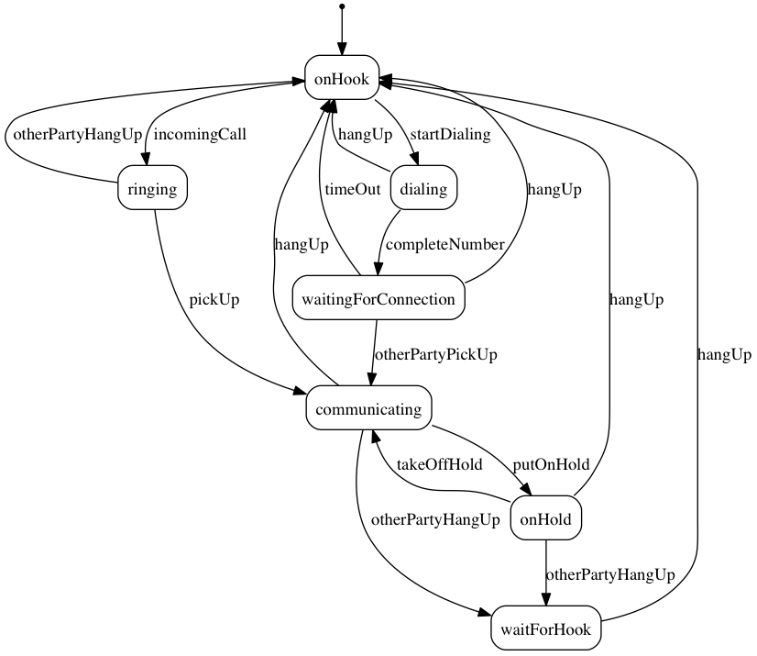
State machine for a phone line

Slide 139
Umple for the phone line example
class phone {
state {
onHook {
startDialing -> dialling;
incomingCall -> ringing;
}
ringing {
pickUp -> communicating;
otherPartyHangUp -> onHook;
}
communicating {
hangUp -> onHook;
otherPartyHangUp -> waitForHook;
putOnHold -> onHold;
}
onHold {
hangUp -> onHook;
otherPartyHangUp -> waitForHook;
takeOffHold -> communicating;
}
dialing {
completeNumber -> waitingForConnection;
hangUp -> onHook;
}
waitingForConnection {
otherPartyPickUp -> communicating;
hangUp -> onHook;
timeOut -> onHook;
}
waitForHook {
hangUp -> onHook;
}
}
}

Slide 140
In-class modeling exercise for state machines
Microwave oven system state machine
  Events include
    pressing of buttons
    door opening
    door closing
    timer ending
    etc.

Slide 141
Outline
Introduction: Who am I and who are you?
Overview of Agility
Overview of Model-Driven Development
    Languages / Tools / Motivation for Umple
Agile Class Modeling
    Tools / Attributes / Methods / Associations / Exercises / Patterns
Agile Modeling with State Machines
    Basics / Concurrency / Case study and exercises
Separation of Concerns in Models
    Mixins / Aspects / Traits
More Case Studies and Hands-on Exercises
    Umple in itself / Real-Time / Data Oriented
Conclusion

Slide 142
Mixins

Slide 143
Separation of concerns by mixins in Umple
Mixins allow including attributes, associations, state machines, groups of states, stereotypes, etc
Example:
class X { a; }
class X { b; }
  The result would be a class with both a and b.
It doesn’t matter whether the mixins are
  Both in the same file
  One in one file, that includes the other in an other file
  In two separate files, with a third file invoking them

Slide 144
Typical ways of using mixins
Separate model files (classes, attributes associations)
… from files for the same class containing methods
  Allows a clearer view of the core model
Separate system features, each into a separate file

Slide 145
Advantages and disadvantages of mixins
Advantages:
  Smaller files that are easier to understand
  Different versions of a class for different software versions (e.g. a professional version) can be built by using different mixins
Disadvantage
  Delocalization:
    Bits of functionality of a class in different files
    The developer may not know that a mixin exists unless a tool helps show this

Slide 146
Aspect orientation

Slide 147
Aspect orientation
Create a pointcut that specifies (advises) where to inject code at multiple points elsewhere in a system
  The pointcut uses a pattern
  Pieces of code that would otherwise be scattered are thus gathered into the aspect
But: There is potentially acute sensitivity to change
  If the code changes the aspect may need to change
  Yet without tool support, developers wouldn’t know this
Delocalization even stronger than for mixins

Slide 148
Aspect orientation in Umple
Pointcuts are currently limited to a single class
  Just inject code before and after execution of methods and constructors
class Person {
name;
before setName {
if (aName != null && aName.length() > 20) { return false; }
}
}
We have found these limited abilities nonetheless solve key problems

Slide 149
Traits

Slide 150
Separation of concerns by traits
Allow modeling elements to be made available in multiple classes
trait Identifiable {
firstName;
lastName;
address;
phoneNumber;
fullName = {firstName + " " + lastName}
Boolean isLongName() {return lastName.length() > 1;}
}
class Person {
isA Identifiable;
}
See more complete version of this in the user manual

Slide 151
Another trait example
trait T1{
abstract void method1(); /* required method */
abstract void method2();
void method4(){/*implementation – provided method*/ }
}
trait T2{
isA T1;
void method3();
void method1(){/*implementation*/ }
void method2(){/*implementation*/ }
}
class C1{
void method3(){/*implementation*/ }
}
class C2{ isA C1; isA T2;
void method2(){/*implementation*/ }
}

Slide 152
Traits with parameters
trait T1< TP isA I1 > {
abstract TP method2(TP data);
String method3(TP data){ /*implementation*/ }
}
interface I1{
void method1();
}
class C1{ isA I1;
isA T1<TP = C1>;
void method1(){/*implementation*/}
C1 method2(C1 data){ /*implementation*/ }
}
class C2{
isA I1;
isA T1< TP = C2 >;
void method1(){/*implementation*/}
C2 method2(C2 data){ /*implementation*/ }
}

Slide 153
Trait parameters in methods
trait T1 <TP>{
String method1();
String method2(){
#TP# instance = new #TP#();
return method1() +":"+instance.process();
}
}
class C1{
String process(){/*implementation*/}
}
class C2{
isA T1< TP = C1 >;
String method1(){/*implementation*/ }
}

Slide 154
Selecting subsets of items in traits
trait T1{
abstract method1();
void method2(){/*implementation*/}
void method3(){/*implementation*/}
void method4(){/*implementation*/}
void method5(){/*implementation*/}
}
class C1{
isA T1<-method2() , -method3()>;
void method1() {/*implementation related to C1*/}
}
class C2{
isA T1<+method5()>;
void method1() {
/*implementation related to C2*/}
}

Slide 155
Renaming elements when using traits
trait T1{
abstract method1();
void method2(){/*implementation*/}
void method3(){/*implementation*/}
void method4(){/*implementation*/}
void method5(Integer data){/* implementation*/}
}
class C1{
isA T1< method2() as function2 >;
void method1() {/*implementation related to C1*/}
}
class C2{
isA T1< method3() as private function3 >;
void method1() {/*implementation related to C2*/}
}
class C3{
isA T1< +method5(Integer) as function5 >;
void method1() {/*implementation related to C3*/}
}

Slide 156
Associations in traits: Observer pattern
class Dashboard{
void update (Sensor sensor){ /*implementation*/ }
}
class Sensor{
isA Subject< Observer = Dashboard >;
}
trait Subject <Observer>{
0..1 -> * Observer;
void notifyObservers() { /*implementation*/ }
}

Slide 157
Using traits to reuse state machines
trait T1 {
sm1{
s0 {e1-> s1;}
s1 {e0-> s0;}
}
}
trait T2 {
isA T1;
sm2{
s0 {e1-> s1;}
s1 {e0-> s0;}
}
}
class C1 {
isA T2;
}

Slide 158
Satisfaction of required methods through state machines
trait T1{
Boolean m1(String input);
Boolean m2();
sm1{
s1{
e1(String data) -> /{ m1(data); } s2; }
s2{
e2 -> /{ m2(); } s1; }
}
}
class C1{
isA T1;
sm2{
s1{ m1(String str) -> s2;}
s2{ m2 -> s1;}
}
}

Slide 159
Changing name of a region
trait T1{
sm {
s1{
r1{ e1-> r11; }
r11{}
||
r2{ e2-> r21; }
r21{}
}
}
}
class C1{
isA T1<sm.s1.r1 as region1,sm.s1.r2 as region2>;
}

Slide 160
Changing the name of an event
trait T1 {
sm1{
s0 { e1(Integer index)-> s1;}
s1 {e0-> s0;}
}
sm2{
t0 {e1(Integer index)-> t1;}
t1 {e0-> t0;}
}
}
class C1 {
isA T1<sm1.e1(Integer) as event1, *.e0() as event0>;
}

Slide 161
Outline
Introduction: Who am I and who are you?
Overview of Agility
Overview of Model-Driven Development
    Languages / Tools / Motivation for Umple
Agile Class Modeling
    Tools / Attributes / Methods / Associations / Exercises / Patterns
Agile Modeling with State Machines
    Basics / Concurrency / Case study and exercises
Separation of Concerns in Models
    Mixins / Aspects / Traits
More Case Studies and Hands-on Exercises
    Umple in itself / Real-Time / Data Oriented
Conclusion

Slide 162
Unit Testing with Umple
To see how to integrate Unit Testing with Umple, see the sample project at
  https://github.com/umple/umple/tree/master/sandbox
And the build script at
  https://github.com/umple/umple/blob/master/build/build.sandbox.xml
Command line from build directory
ant -f build.xml sandbox

Slide 163
Case study: Digital watch
Look at the Digital Watch example in UmpleOnline

Slide 164
Case Study: Canal Locks
Look at the Canal Locks and Canal Locks state machine in UmpleOnline
http://manual.umple.org/?CanalSystem.html

Slide 165
Case Study: Exam seating
eseat: A tool to randomize exam plans
  Real-world application of Umple
Some problems:
  In lecture halls, students writing exams must be allocated a space between them
  Multiple exams may be assigned to a room
  An exam may be split between multiple rooms
Output needed:
  Overview: For each exam, which students go in which room
  Lists of students to find their seat in each room
  Seat-order lists for verification by proctors

Slide 166
Umple Technologies Used in eseat
Class diagram
  umple2svgcd eseat.ump
Mixins
Template generation (html generation library)
Reuse of non-Umple libraries (for reading .xlsx)

Slide 167
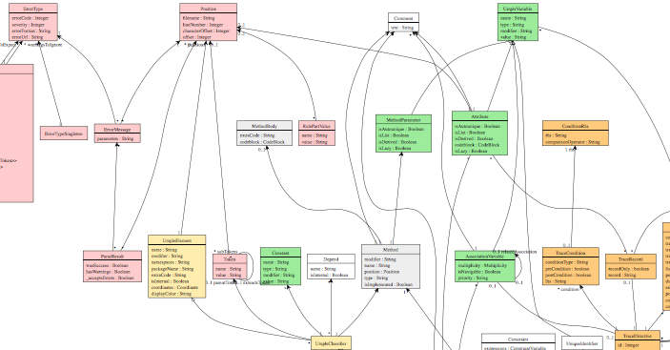
A Look at How Umple is Written in Itself
Source:
https://github.com/umple/umple/tree/master/cruise.umple/src
Umple’s own class diagram generated by itself from itself:
  http://metamodel.umple.org
  Colours represent key subsystems
  Click on classes to see Javadoc, and then Umple Code

Slide 168
Testing:
TDD with100% pass always required
Multiple levels:
  Parsing tests: basic constructs
  Metamodel tests: ensure it is populated properly
    E.g.
    https://github.com/umple/umple/blob/master/cruise.umple/test/cruise/umple/compiler/AssociationTest.java
  Implementation template tests: to ensure constructs generate code that looks as expected
  Testbed semantic tests: Generate code and make sure it behaves the way it should

Slide 169
Umple issues list
Tagged by
Priority
Perceived difficulty
Scale (bug, project, research project)
Milestone (slow release)
http://bugs.umple.org

Slide 170
Using Umple with Builds and Continuous Integration
Example build scripts
Example travis.yml
Umple’s own Travis page

Slide 171
Umplification

Slide 172
Outline
Introduction: Who am I and who are you?
Overview of Agility
Overview of Model-Driven Development
    Languages / Tools / Motivation for Umple
Agile Class Modeling
    Tools / Attributes / Methods / Associations / Exercises / Patterns
Agile Modeling with State Machines
    Basics / Concurrency / Case study and exercises
Separation of Concerns in Models
    Mixins / Aspects / Traits
More Case Studies and Hands-on Exercises
    Umple in itself / Real-Time / Data Oriented
Conclusion

Slide 173
Making the case to management
Agility and modeling both help you improve
Speed, Quality, Functionality, Financial viability
Umple helps you model better while being agile
  Textual nature enables version control, usability
  Quality code generation
Umple adoption is low-risk
  Can be adopted incrementally
  Multi-platform compatibility / multi-language / low dependency
  Although generated code should not be edited, it is of high quality so can be inspected and serves as fall-back
  One of the most actively developed modeling tools available

Slide 174
Evidence of benefit in umple
Umple in use an a couple of small companies
Uptake by more and more professors in teaching
Our empirical studies show
  Umple code is easier to understand than Java
  Helps students learn to model
We would not have been able to develop and maintain the Umple compiler as effectively without merging modeling and programming

Slide 175
Conclusion
Umple
  Is simple but powerful modeling tool
  Generates state-of-the-art code
  Enables agility + model-driven development
  We call the overall approach model-based programming

Slide 176
End of the workshop
Thank-you!

