Slide 1
The Convergence of Modeling and Programming:
Facilitating the Representation of Attributes and Associations in the Umple Model-Oriented Programming Language
Thesis Defence
Presented to the Faculty of Graduate and Postdoctoral Studies in partial fulfillment of the requirements for the degree Doctor of Philosophy (Computer Science)
Notes:
Welcome to the presentation of “The Convergence of Modeling and Programming”. let us begin with a quick summary of the Umple model-oriented programming language, which forms the backbone of the thesis being defended today.

Slide 2
Umple = Model = Code
Notes:
The airline example will be preloaded
Umple is a programming language that incorporates modeling constructs, in addition to software idioms and patterns. It can behave like your typical modeling environment with a diagramatic view – as shown on the right; but it also behave like a normal PL like Java – as shown on the left.
Both views represent the same underlying system, and editing one view is directly reflected in the other. Note that both side do hide some information, but this is a tooling feature.
Let us start fresh, and to provide a more detailed, but isolated view of the language.
Umple supports attributes including a variety of qualifiers such as immutable, defaulted, derived.
class Student {
name;
immutable Integer id;
defaulted Integer yearOfStudy = 1;
toS = { $this->getName() + ":" + $this->getId() }
}
Umple supports associations, which includes all varieties of multiplicity ends.
class Mentor
{
0..1 -- 0..1 Student;
}
Umple supports additional software patterns, like singleton and software idioms like keys used for hash codes and equality comparisons.
class Student {
key { id }
}
class University
{
singleton;
}
Umple supports AOP techniques like the ability to inject behaviour before and/or after a method executes.
class Student {
before setName { print "About to set name, current value is {$this->getName()}"; }
after setName { print "Just set name, current value is {$this->getName()}"; }
}
Umple also supports Mixins, for greater flexibility to extend and enhancing existing systems without having to rely on a pre-existing inheritance or well defined composite structure
association
{
* University -- * Student;
}
class Student
{
lastName;
}

Slide 3
Overview
Research Questions and Hypothesis
Contributions
Future work
Notes:
For the remainder of this presentation will we review the research questions and hypothesis that guided this research, we will identify the primary contributions and look to possible next steps

Slide 4
Research Questions
RQ1: Why resist modeling?
RQ2: Perceptions of software modeling?
RQ3: Model in Code?
Notes:
The three questions guided are research were, why might practitioners resist modeling, what are their preceptions of modeling and finally can models be represented in code?

Slide 5
The code is the model, the model is the code
Hypothesized Solution (H1)
Notes:
Software development can be enhanced by providing a textual format to write and maintain software constructs and abstractions that have previously been diagrammatic in nature.

Slide 6
RQ1 – Addresses Model Resistance
Umple is NOT yet another language
Code-centric AND model-centric
Code-first OR model-first
No Installation Required (Excellent for teaching)
Notes:
Habituation: Umple extends programming languages
Efficacy: It is code-centric with diagrams
Politics and Practices: It supports modeling-first and coding-first
Software Process: Support for big-design up-front, iterative/incremental, agile, and evolutionary prototype.
Tool Weaknesses: Umple needs only a text editor, but does integrate with full-fledged IDEs like Eclipse.
Intrinsic Utility: Umple can be developed in text, leveraging text-manipulation tools, and avoiding mouse movements
Software Engineering Education: UML can now be taught interactively in any classroom with Internet access.

Slide 7
RQ2 – Perceptions on modeling?
Yes, UML is dominant notation
Model-oriented usually provides better approach
But, most revert back to code
Umple eliminates the distinction
Coders can model
Modelers can code
Both can share the same artefacts
Notes:
Following a survey of software practitioners we found that UML is the predominant model notation, and that in several software development scenarios such as understanding a design, building a new system, etc that model-oriented was preceived as a more appropriate approach BUT most revert back to code for the day-to-day activities.
Umple eliminates the distinction between modeling and coding and allows both modelers and coders to share the same artefacts – resulting in not only “the code is the model, but also the model is the code”.

Slide 8
RQ3 – Model-oriented languages?
Umple is the working example
No round trip required
No reverse engineering
To evaluate,
Dissected attributes and associations
Impacts on program comprehension
Built / modelled real systems
Notes:
Umple is a working example of incorporating model constructs into a programming language – our approach as eliminated the need for round-trip engineering which also removed the need for complex reverse engineering tools to manage changes between model and code.
To evaluate our Umpe approach, we dissected attributes and associations in great detail, we looked at the potential gains in program comprehension of a Umple based system and finally we built and modelled real systems with real clients to demonstrate by example.

Slide 9
Summary of Contributions
Software Application Taxonomy [18]
Survey on Software Modeling [19, 163]
Umple, a model oriented programming language [26, 41, 163]
Online modeling environment [3]
Practical and significant systems built in Umple
Online repository of modeling examples [3]
Notes:
The chronology of the contributions of the thesis began with a building a software application taxonomy. Here we structured over 190 different types of software applications amongst 4 high level categories ranging from data dominant to computation dominant.
Next, we conducted a survey of software practitioners to gauge their perceptions towards software modelling. We used the high-level software application categories to allow for sub-sampling of the data and the results of this work led to the creation of Umple – a model oriented programming language.
To facilitate adoption, to made a online version of the tool available – effectively providing a near zero-footprint installation.
Next, we built practical and significant systems in Umple, and analyzed various aspects of the those system for qualities like program comprehension.
Finally, we created a relatively large and growing repository of modeling example – available online.

Slide 10
Code Generation Patterns
Attributes
Associations
Set/Get (UB = 1)
Add/Remove/NumberOf/IndexOf/Get (UB > 1)
Lazy immutability
Default values
Constants
Before / After code injection
Set/Get (UB = 1)
Add/Remove/NumberOf/IndexOf/Get (UB > 1)
Referential Integrity
Multiplicity Constraints
42 different cases
Notes:
I want to draw attention to the code generation patterns that were developed, and in particular looking at attributes and associations. We analyzed the semantics of attributes and associations, as well as looked at their use in real system to help develop a comprehensive approach to code generation. In addition to providing a suitable API, i.e. set / get methods, we considered other aspects such as dealing with the immutability in the face of Factory Patterns, as well as maintaining Referential Integrity and Multiplicity constraints without burdening the resulting API or creating objects that were not modelling in the system.

Slide 11
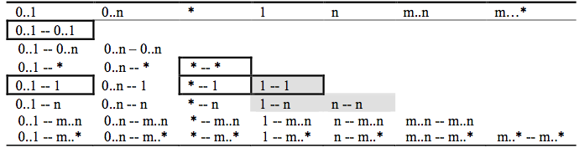
Association Relationships
Directional Associations
* -> 0..1, * -> 1, * -> *, * -> m..n, * - >n, *->m..* and*->0..n.
Symmetric Reflexive
0..1, 0..n, *, 1, n, m..n,m..*
Bidirectional Associations
Notes:
In particular, we considered the 42 different possible combinations for dealing with directional associations, symmetric reflexive associations (e.g. a spousal relationship) and finally the various combinations of bidirectional binary associations.

Slide 12
Language Constructs
Attributes
Association
Classes / Generalizations
Singleton Pattern
AOP (before / after)
Equality Idiom
Mixins
Action Semantics (Java, PHP, Ruby)

Slide 13
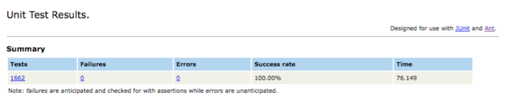
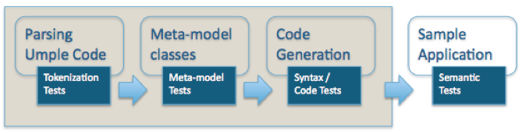
Emphasis on Quality
Notes:
As most like to claim their work is of high quality, we too make that claim. Be segmenting the internal processes used by the Umple tooling, we were able to demonstrate a systematic approach to dealing with defects, regressions and enhancements to the Umple language and complimentary tooling.

Slide 14
Research Directions
Usability evaluation
Enhance action semantics pre-processing
State Machine
  Nested / concurrent states
Software patterns
  Embed constructs versus facilitated in a PL
Diagram Layout
  Auto layout
  Layout hints
  Enhanced views (i.e. object APIs)
Enhanced mixins
  “substitute-ins”
Notes:
Where do we go next? I am personally interested in looking at the implementation of software patterns, and in particular analyzing the differences between embedding explicit constructs within the language to support patterns, like the singleton patter versus facilitating them in a PL. Current software patterns only deal with the facilitating aspects – but now that we have our model oriented language I am intrigued by the idea that some patterns could become “obsolete” (from a boiler plate code perspective) “IF ONLY” ….. Fill in the gap with the research … were available. Example patterns include façade, adapter, and observer.
I am also interesting in approaches to usability testing. A topic that Dr. Lethbridge and I have spoke of but are still considering the approaches to gather research quality data / observations as opposed to anchedotal evidence.
Current student are working on state machines, and potential new students could work on the diagramming aspects of Umple helping to provide better auto layout capabilities, including layout hints.

Slide 15
Additional Notes
To be referenced during the question period based on the reviewers questions

Slide 16
Software Application Taxonomy

Slide 17
Software Application Taxonomy [18]
Help provide application context when analyzing experiment results [18]
Allows strong approaches in application domains to solve specific problems
Can help with re-use:
  Methodologies,
  Languages,
  Paradigms
Partial structure on right
A. Data-dominant systems
A.con Consumer-oriented software
A.bus Business-oriented software
B. Systems software
B.os Operating systems
B.net Networking / Communications
C. Control-dominant software
C.hw Hardware control
C.em Embedded software
D. Computational-dominant software
D.or Operations research
D.im Information management and manipulation

Slide 18
Why do we care?
Software engineering practices, principles and pragmatics should not be adopted just because someone
  had proposed them,
  or found them to work in certain situations
Rather, they must be
  evidence-based
  contextual
Evidence should be supported under a well-defined set of conditions
One key condition is the type of software being built
Notes:
Why do we care are about software types?
Software engineering practices, principles and pragmatics should not be adopted just because someone
had proposed them,
or found them to work in certain situations
Rather, they must be
evidence-based
contextual
Evidence should be supported under a well-defined set of conditions

Slide 19
Benefits of Knowing Software Types
For academic research to help label
under what circumstances research was performed, or
where software processes / tools / methodologies seem to fit best.
For corporate environments, to know whether the evidence an engineer intends to rely on is applicable to their particular application domains.

Slide 20
Methodology to Build Our Taxonomy
Guiding Principles
Input from both published material and experts,
Iterative review, and
Careful editing of the results
Statistics
78 Sources
53 volunteers
25 online sources (ACM, IEEE, Google, SourceForge)
191 categories, 4 levels

Slide 21
Methodology to Build Our Taxonomy (continued)
Step 1: Seed the process with existing taxonomies.
Step 2: Conduct multiple tool-supported individual brainstorming sessions.
Step 3: Merge the brainstorm results to form a full first draft.
Step 4: Refine the taxonomy by applying systematic criteria for subdivision.
Step 5: Review and edit the result iteratively.

Slide 22
Step 1: Taxonomy Initial Seed
Audio Clustering Communications Database Desktop Development Tools Distributions and Standards Education Enterprise Financial Games/Entertainment Graphics Hardware Information resources Linux Management and Business Miscellaneous Multimedia / Publishing Networking / Telecom | Office/Business Operating Systems Plugin Printing Programming Religion Scientific / Engineering Security Sociology Storage Student System and Network Utilities Terminals Text Editors Utility Voice Over IP (VoIP) Web / Internet Windows XML

Slide 23
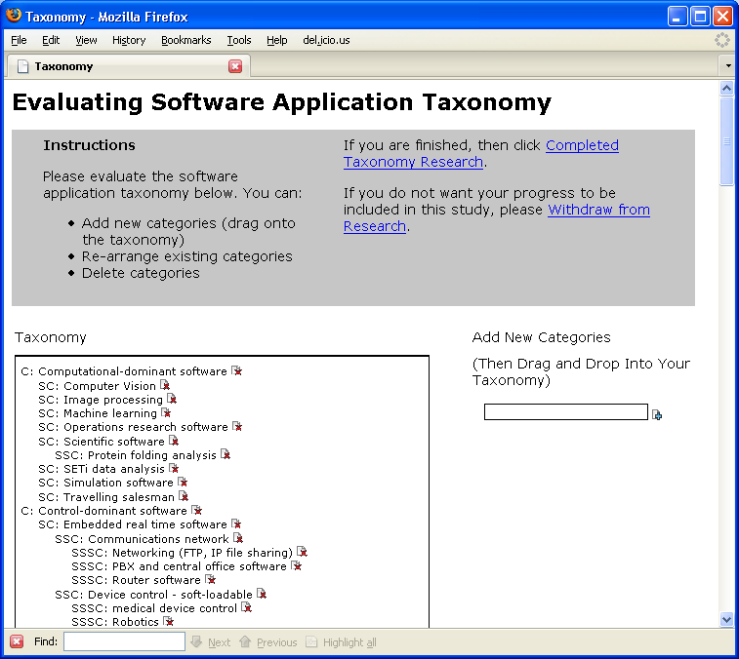
Step 2: Build Software Taxonomy

Slide 24
Step 4: Criteria To Divide Taxonomy
Level | Parent | Criteria for subdividing
1 | Root | Data Dominant to Computation Dominant
2 | A. Data-Dominant Systems | Target user audience (consumer, designer, and information-seeker)
2 | B. Systems software | Level of abstraction (low to high-level)
2 | C. Control-dominant software | Scale of control (small to large)
2 | D. Computation-dominant software | Conceptual dimension (practical to theoretical)
3 | All | Application domain (e.g. communication, entertainment, education)
4 | All | Features / functions (e.g. web browsers, email, financial analysis)

Slide 25
Software Application Taxonomy
(Level 1)
A. Data-dominant software
B. Systems software
C. Control-dominant software
D. Computation-dominant software

Slide 26
Software Application Taxonomy
(Level 1 and 2)
A Data-dominant software
  A.con Consumer-oriented software
  A.bus Business-oriented software
  A.des Design and engineering software
  A.inf Information display and transaction entry
B. Systems software
  B.os Operating systems
  B.net Networking / Communications
  B.dev Device / Peripheral drivers
  B.ut Support utilities
  B.mid Middleware and system components
  B.bp Software Backplanes (e.g. Eclipse)
  B.svr. Servers
  B.mal Malware
C. Control-dominant software
  C.hw. Hardware control
  C.em. Embedded software
  C.rt. Real time control software
  C.pc. Process control software (i.e. air traffic control, industrial process, nuclear plants)
D. Computation-dominant software
  D.or. Operations research
  D.im. Information management and manipulation
  D.art. Artistic creativity
  D.sci Scientific software
  D.ai Artificial intelligence

Slide 27
Software Application Taxonomy
(Subset Examples)
A Data-dominant software
A.con Consumer-oriented software
  1 Communication and information
    a Voice
    b Text / Chat
    c. Email
    d Web browsers
    e. Personal Information management (calendaring, address book)
    f. File / document sharing (i.e. FTP)
B. Systems software
B.os Operating systems
  1. Accessibility
  2. Administrator software and tools
  3. Emulation / emulators
  4. Games console operating systems
  5. Virtual machines
  6. Kernels / distributions (e.g. Linux, Mac, Windows, Palm, QnX)

Slide 28
How can you apply the taxonomy?
Academic Research
Academic Education
Software Practitioners

Slide 29
Application to Academic Research
Surveys and questionnaires to gather demographic information about the participants.
  Allow for more standard sub-sampling among different studies.
Experimental or other empirical results should indicate which application domains were used in the study.
Retrospective analysis should be performed on existing research that gathered application type information.

Slide 30
Application to Academic Education
Curriculum designers can review course selection to promote a certain niche, or ensure a broad coverage
  Software gaming (niche), or
  General software engineering (coverage)
Academics can create case studies, textbooks, and problem sets that indicate the application types to which they are relevant

Slide 31
Application to Software Practitioners
Helps to make decisions about
Software methodologies.
Design patterns and component frameworks.
Algorithms.
Software engineering tools such as IDEs,
Data and exchange formats such as XML, YAML, and JSON.
Architectures and architectural styles.
Testing techniques including unit, integration, system, user acceptance and smoke testing.

Slide 32
Methodology To Build Our Taxonomy
Guiding Principles
Input from both published material and experts,
Iterative review, and
Careful editing of the results
Statistics
78 Sources
53 volunteers
25 online sources (ACM, IEEE, Google, SourceForge)
191 categories, 4 levels

Slide 33
Software Modeling Survey

Slide 34
Survey on Software Modeling [19, 163]
Quantitative perspective on attitudes towards modeling
Models are more than just diagrams; can include text
Model-centric seems to fit better, but uncommon in practice
Modeling tools mostly used to transcribe models to a digital format; more then brainstorming or generating code
Category | N | %
All Participants | 113 | 100%
Participants in Canada/USA | 63 | 56%
Participants Outside Canada/USA* | 27 | 24%
Software Developers | 53 | 47%
Software Modellers | 46 | 41%
Participants that Generate Code | 15 | 13%
Experienced Participants (≥ 12 years) | 53 | 47%
Participants in Real-Time Projects | 19 | 17%
Models quickly become out of date with respect to code, and the code often poorly reflects the design intent of the system

Slide 35
Empirical Study: Attitudes about Modelling
Objective: Understand how software engineers
  think about modelling
  … and do modelling
  … so we can develop better tools
Types of questions
  What is a model?
  How do you create / modify software models?
  How do you learn about the design of software?
  What modelling notations do you use?
  What problems do you experience when
    Modelling
    Not modelling

Slide 36
Empirical Study: Attitudes to Modelling
Objective: Understand how software engineers think about modelling, and do modelling so we can develop better tools
Asking various questions such as:
  What is a model?
  How do you create / modify software models
  How do you learn about the design of software
  What modelling notations do you use?

Slide 37
Empirical Study: Overview
113 Participants
18 questions
Demographics
  Average 14 years of SE experience
  56% from Canada and United States
  24% Other regions include United Kingdom, Other parts of Europe, India, Pakistan, Australia, Mexico and Singapore
  Remainder did not indicate location
Roles in software engineering
  Modelers: 41%
  Generate code from models: 14%
  Real-time developers: 17%

Slide 38
Model-Centric to Code-Centric
Model-only: The model is effectively all there is, except for small amounts of “code”.
Model-centric: Model first, generate code, and then possible manual coding/manipulation.
Model-as-design-aid: Model to design, then code written by hand.
Model-as-documentation: Model to describe a system, after code is written.
Code-centric: Modeling is almost entirely absent.

Slide 39
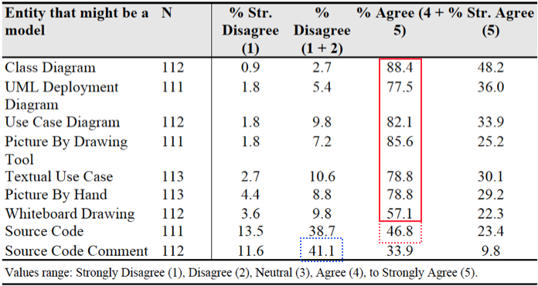
Data: Q1 Which of These is a Model?
Implication: Integrate source and model

Slide 40
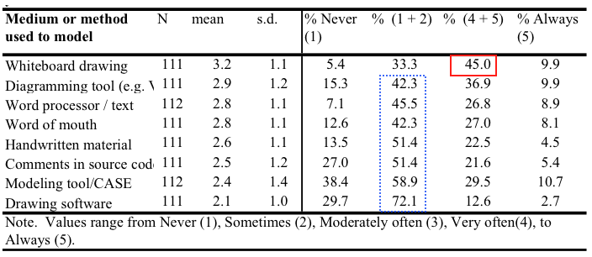
Data: Q2 How Participants Model
Implication
  Improve modeling tools to increase adoption
  Provide a way to brainstorm electronically

Slide 41
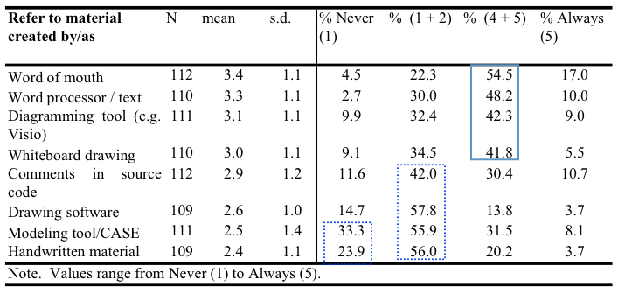
Data: Q3 How Participants Learn About Software
Implication
  Help create live documents from models

Slide 42
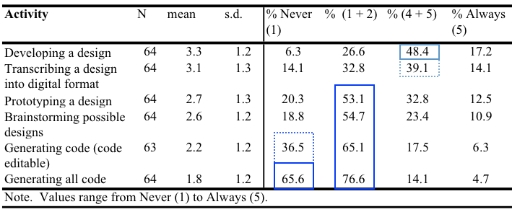
Data: Q11 How Modeling Tools Are Used
Implication
  Improve brainstorming and initial quick early design
  Code generation

Slide 43
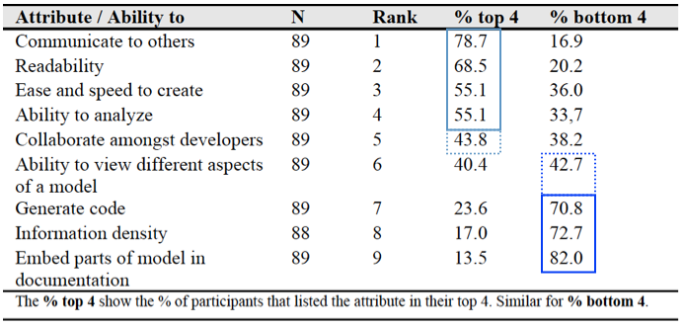
Data: Q13 Most Desired Characteristics of a Modeling Tool
Implication
  Focus on ease of use of models
  Generation may be low because users are not convinced it works

Slide 44
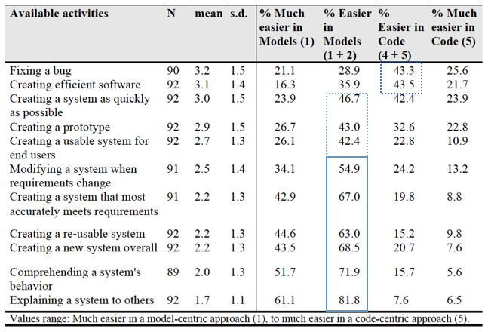
Data: Q14 Easier with Code (top) vs. Model (Bottom)

Slide 45
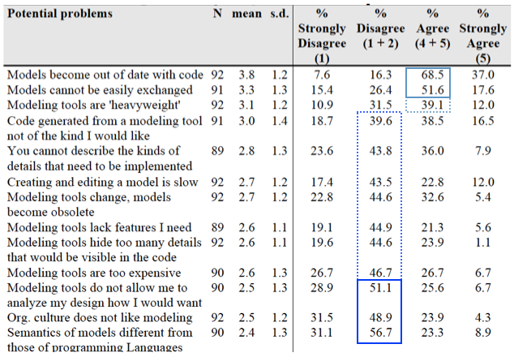
Data: Q15 Problems with Model-Centric Approach

Slide 46
Implications of Problems Noted
Focus on either
  Generating all code
  Unifying code with model
Focus on quick and easy modeling

Slide 47
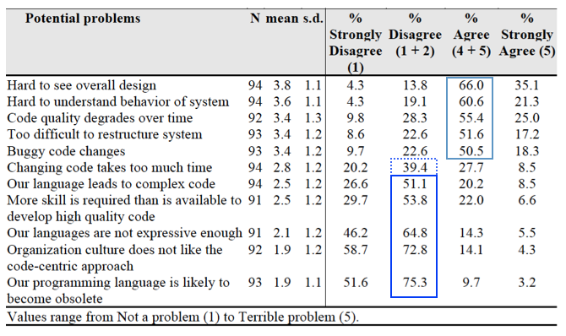
Data: Q16 Problems with Code-Centric Approach

Slide 48
Umple, a model oriented programming language

Slide 49
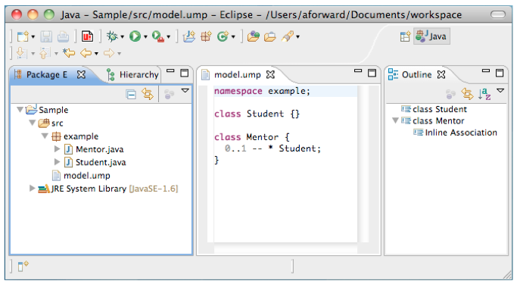
Umple, a model oriented programming language [36, 41, 163]
Support for attributes, associations, state machines, software idioms and patterns
Umple built in itself
10-to-1 code savings for CRUD model constructs

Slide 50
What can you do with Umple
Develop full applications
Model UML classes and state machines
  – they play well together
Seamlessly generate code
  – that you may never need to look at
Program at a higher level of abstraction
Reduce the need for boring / error prone boilerplate code
Generate visual models textually
  – or generate textual code visually
Notes:
Changed it to UML class diagrams and state machines

Slide 51
Umple as a Programming Language
Adds higher levels of abstraction to programming
  UML constructs
    Associations
    Attributes
    States to come
  Patterns / Idioms
Leaves basics of the underlying language unaffected
  Appears like programming to programmers
  Appears like modelling to modellers
Works with Java, PHP, and Ruby

Slide 52
Umple as a Modeling Tool
Work with models in diagram or textual form
Use the power of textual forms
  Easier reuse
  Easier commenting
  Quicker editing
  Enables macros, inclusion, mixins, etc.
  Merging, version control, multi-user development etc.
  Scalability
  … Without losing the power of the graphical form

Slide 53
Declaration of Classes and Attributes
class Student
{
studentNumber; // defaults to String
String grade;
Integer entryAverage;
}

Slide 54
Declaration of Associations
class Student {
id;
name;
}
class Course {
description;
code;
}
association {
* CourseSection;
* Student registrant;
}
class CourseSection {
sectionLetter;
1..* -- 1 Course;
}

Slide 55
Why Umple?
To help simplify programming
  Too much boilerplate code
To overcome the resistance between model-centric and code-centric software engineering
  Proving that models and code need not be far apart
To extend the trend towards higher abstraction in programming
To help educate students in OO programming and modeling
To act as a testbed for research
  Model-oriented programming
  Code generation
  General principles of modelling

Slide 56
Umple Examples

Slide 57
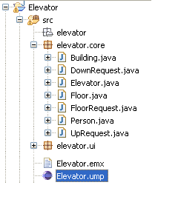
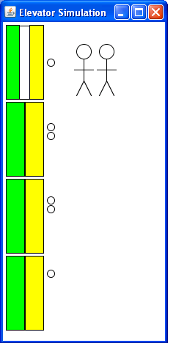
Sample Elevator Application

Slide 58
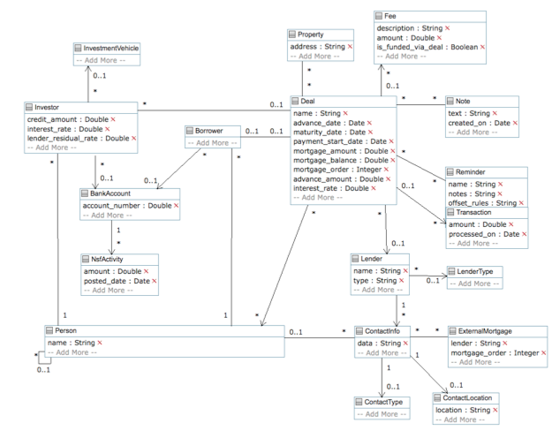
Private Lending Data Model

Slide 59
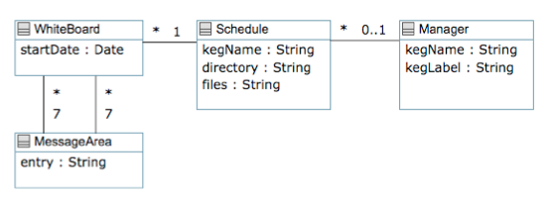
Schedule Model

Slide 60
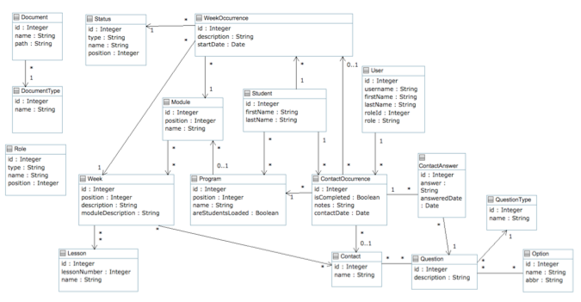
Distance Learning Model

Slide 61
Large online repository of modeling examples
Available at: http://cruise.site.uottawa.ca/umpleonline

Slide 62
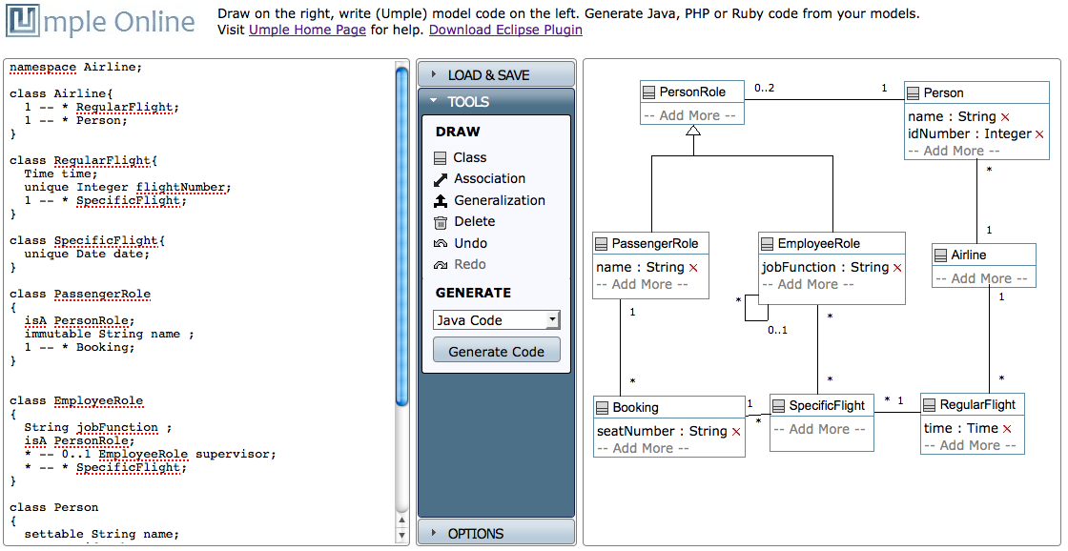
Online modeling environment [3]
UmpleOnline can be used
to introduce people to Umple and popularize it,
to create UML diagrams for publications including this thesis,
for software engineering teaching, and
as a light-weight development environment.

Slide 63
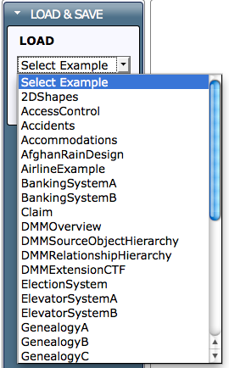
Large online repository of modeling examples
Available at:
http://cruise.site.uottawa.ca/umpleonline
Currently has 34 examples
Diagram and text can viewed, and edited online

Slide 64
Practical and significant systems built in Umple
Umple (v1.10): The latest version of the Umple tooling, Umple+Java
Elevator: An elevator simulation, Umple+PHP and Umple+Java
Schedule Management: Schedules for a restaurant chain, Umple+PHP
Distance Learning Reporting: A
reporting tool for a remote learning, Umple+PHP

Slide 65
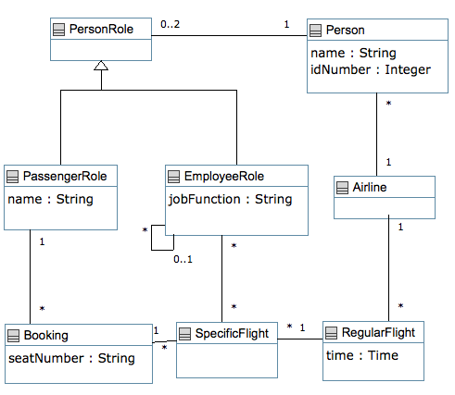
Airline Example

Slide 66
class Airline {
1 -- * RegularFlight;
1 -- * Person;
}
class RegularFlight {
Time time;
unique Integer flightNumber;
1 -- * SpecificFlight;
}
class SpecificFlight {
unique Date date;
}
class PassengerRole {
isA PersonRole;
immutable String name ;
1 -- * Booking;
}
class EmployeeRole
{
String jobFunction ;
isA PersonRole;
* -- 0..1 EmployeeRole supervisor;
* -- * SpecificFlight;
}
class Person
{
settable String name;
Integer idNumber;
1 -- 0..2 PersonRole;
}
class PersonRole{}
class Booking{
String seatNumber;
* Booking -- 1 SpecificFlight;
}

Slide 67
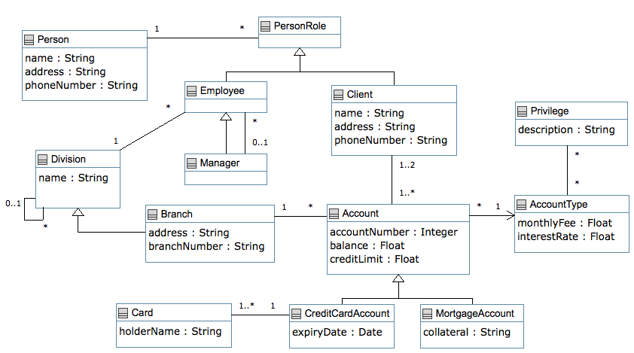
Banking System

Slide 68
class PersonRole{}
class Person {
name; address;
phoneNumber;
1 -- * PersonRole;
}
class Employee{
isA PersonRole;
}
class Client {
isA PersonRole;
name; address;
phoneNumber;
1..2 -- 1..* Account;
}
class Manager {
isA Employee;
0..1 -- * Employee;
}
class Account{
Integer accountNumber;
Float balance;
Float creditLimit;
* -> 1 AccountType;
}
class AccountType
{
Float monthlyFee;
Float interestRate;
* -- * Privilege;
}
class Privilege
{
description;
}
class CreditCardAccount{
isA Account;
Date expiryDate;
1 -- 1..* Card;
}
class MortgageAccount {
isA Account;
collateral;
}
class Card
{
holderName;
}
class Branch {
isA Division;
address;
branchNumber;
1 -- * Account;
}
class Division{
name;
1 -- * Employee;
0..1 -- 0..* Division subDivision;
}

Slide 69
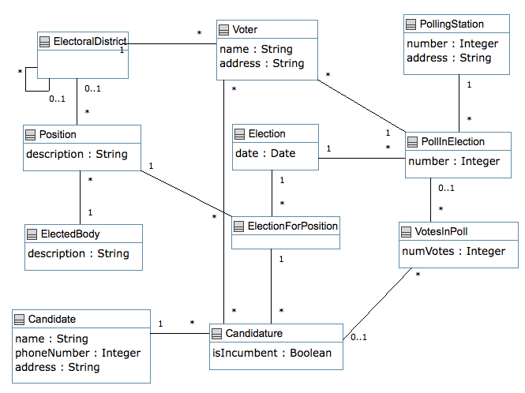
Election System

Slide 70
class PollingStation {
Integer number;
address;
1 -- * PollInElection;
}
class ElectedBody{
description;
1 -- * Position;
}
class Election{
Date date;
1 -- * PollInElection;
1 -- * ElectionForPosition;
}
class ElectionForPosition{
1 -- * Candidature;
}
class Position {
description;
1 -- * ElectionForPosition;
}
class Candidature {
internal Boolean isIncumbent = false;
}
class Candidate {
name;
Integer phoneNumber;
address;
1 -- * Candidature;
}
class PollInElection {
Integer number;
1 -- * Voter;
}
associationClass VotesInPoll{
* Candidature;
* PollInElection;
Integer numVotes;
}
class Voter{
name;
address;
* -- * Candidature;
}
class ElectoralDistrict{
1 -- * Voter;
0..1 -- * Position;
0..1 -- * ElectoralDistrict subDistrict;
}

Slide 71
Goals of MDE
Balancing between creating good software now, with enabling future development of good software
In particular to MDE
Enable as much development at modelling level
  Without need to edit generated code
Enable more rigorous engineering at modelling level
  analysis, testing, verification
Achieved relatively soon, but late adopters might take 20 or more years

Slide 72
Benefits / Drawbacks to MDE
Main Benefit
Documentation / Communication
  Visually document your design / intent for free
  System is built visually from the beginning
Main Drawback
Training
  Not only is modelling a skill, but the tools require significant investment of training
Other Drawbacks
Inefficient programming, tool specific dependency, adoption, difficulty (still) capturing business logic

Slide 73
Why (or why not) MDE
Biggest Obstacle
  Must be efficient for software developers to build software systems (create, edit, maintain, debug)
Best Reason to MDE
  Allows higher order constructs (i.e. more abstract 1st class constructs)
Best Reason NOT to
  Tool support (limited, vendor specific, interoperability issues)

Slide 74
Persons, Places, Dates
10:00 Monday, October 25
Room 707 A, CBY, 161 Louis Pasteur
Student:
Andrew Forward
Chairperson:
Dr. Devinder Gandhi
Thesis Supervisor:
Dr. Timothy Lethbridge
External Examiner:
Dr. James Andrews
  University of Western Ontario
Internal Examiners
Dr. Daniel Amyot
Dr. Yvan Labiche
Dr. Stéphane Somé

Slide 75
Online reference
Thesis and supplementary documentation available of download at:
  http://www.site.uottawa.ca/~tcl/gradtheses/aforwardphd/
  http://cruise.site.uottawa.ca/umpleonline/
All references within this document align with references in the thesis
Follow-up questions / comments to aforward@gmail.com

