Slide 1
DISTRIBUTED CLUSTERING OF UBIQUITOUS DATA STREAMS
KANIKA JUNEJA (8779271)
GEORGE PATRICK XAVIER (8844824)

Slide 2
OUTLINE
Introduction
Motivation
Clustering Techniques
Distributed clustering methods
Clustering Ubiquitous streaming data observation
Clustering Ubiquitous streaming data sources
Centralized clustering
Conclusion

Slide 3
Introduction
Ubiquitous data streams
Knowledge discovery from ubiquitous data stream has become a
major goal for all sorts of applications
Mostly based on unsupervised techniques such as clustering.
Two subproblems exist
Clustering Streaming data observation
Clustering streaming data sources

Slide 4
Motivation And AIM
Do distributed stream clustering algorithms improve data mining results when applied to ubiquitous data stream scenarios?
The specific objectives of this work include
Exposing scenarios where data are produced as ubiquitous data streams.
Identifying clustering algorithm for ubiquitous data streams.
Pointing out advantages and disadvantages of distributed procedure.

Slide 5
Various Clustering Techniques
Clustering techniques
Clustering Streaming Data Sources
Ubiquitous Data Clustering
Clustering Streaming Observation
Task of clustering data flowing from a continuous stream based on data point similarity.
Task of clustering different sources of data streams, based on data series similarity
Instead of centralizing data, the entire process is distributed.

Slide 6
Clustering Streaming Observation
Algorithms usually search for dense regions, identifying hot spots where it tends to produce data.
A streaming clustering algorithm must observe certain characteristics
Quick and incremental processing of new observations
Execution of only one pass over the dataset.
Running inside a limited RAM buffer

Slide 7
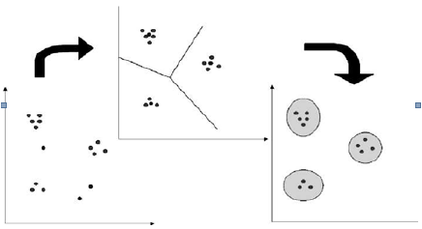
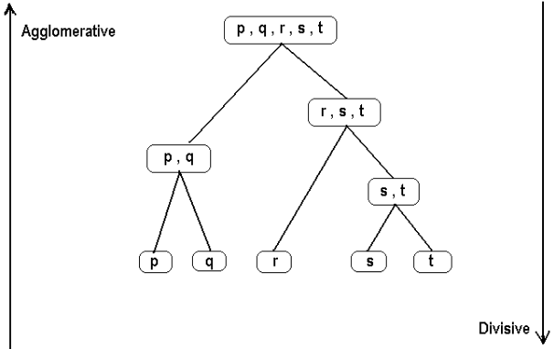
Clustering Streaming Data Sources
Basic idea behind clustering streaming data sources is to find groups of sources that behave similarly through time.
Two Approaches
Partitional Clustering
Hierarchical Clustering
A division data objects into non overlapping clusters such that each data object is exactly in one cluster

Slide 8
Ubiquitous data clustering
Our world is evolving into a setting where all devices as small as they may be, will be able to include sensing and processing ability.
With the purpose of processing and analyzing ubiquitous data, usual knowledge discovery approaches are based on unsupervised techniques.
Data are being generated by web clicks or network package routing on each machine
GPS devices produce an process data locally.

Slide 9
Continued
Different frameworks could be applied on data that are being produced in multiple locations.
First approach was centralized process that would gather data from sensors, analyzing it afterward in a unique multivariate stream.
Another approach could process in two levels-
Clustering the data produced by each sensor separately
Then compiling the result s on a centralized process that will define the final cluster.

Slide 10
Distributed Clustering Methods

Slide 11
Clustering Ubiquitous Streaming Data Observations

Slide 12
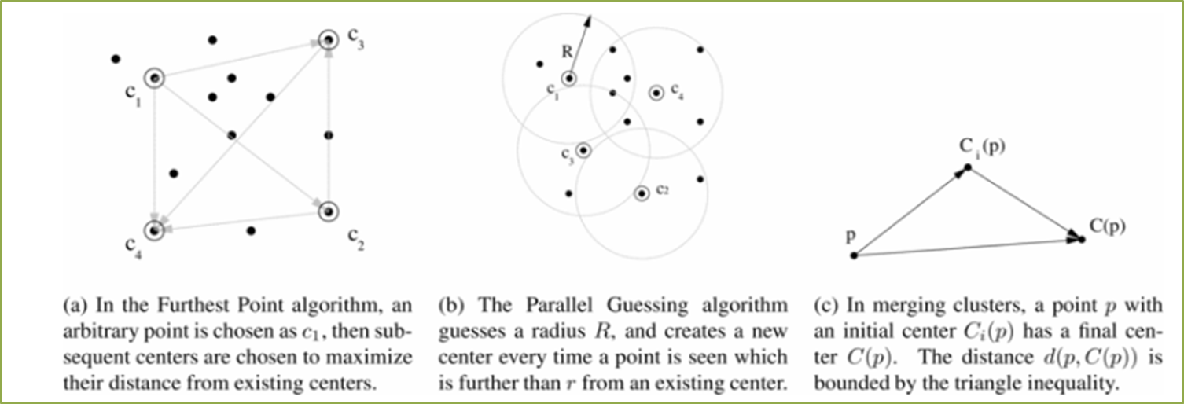
Generalized Methods For Distributed Clustering
Algorithm to achieve clustering of homogenously distributed data streams with local and global computation to balance communication cost.

Slide 13
More than a generalized clustering algorithm Wolff et all.
Generic local algorithm for computing a given function on the averages of the input vectors, produced homogeneously across distributed nodes.
L2-norm threshold, vector mean monitoring, k-means monitoring
Compared the effect of sampling on both centralized and distributed algorithms

Slide 14
Improvements by Zhang , Qiang.
Reduce communication, algorithms for (1−Ꜫ) approximate k-median clustering on distributed data streams.
Grid-based methods for incremental and parallel clustering for very large databases.
The first one (WINP) uses a space-sliding window.
Topology oblivious
Height-aware
Path-aware
The second one (SMIP) identifies high-density cells.

Slide 15
Domain Specific Methods
Distributed Grid Clustering (DGClust), each node of a sensor network produces a univariate stream of data.
Main aim is to cluster the observations produced as the global multivariate state of the network composed by all sensor streams.
Works by using local discretization of streams to reduce communication in the network.
Centralized clustering of most frequent global states to reduce dimensionality of the clustering problem.

Slide 16
Improvement by Son et all.
Clustered version of the in-network distributed optimization algorithm
communication reduces from O(mn), in the centralized scenario to O(√n)
Forming √n clusters, transport cost is equivalent to that of the distributed in-network scheme
While increasing (accuracy of estimate and convergence speed) and reducing latency.

Slide 17
Web Based Scalability Issues
Problem imposed by recent web search engines, an efficient parallel query processing is required, under situations of continuous streams of queries.
Another relevant problem in web scenarios is related to recommender systems, where websites may recommend items to users.
Finally, hot-topic is data mining on mobile devices.
Road safety issues, proposing a fuzzy logic approach for ubiquitous data clustering.

Slide 18
Clustering Ubiquitous Streaming Data Sources

Slide 19
Centralized Clustering
Clustering of mobile peers which have similar moving patterns and exhibit similar data affinity in order to improve a cooperative cache management in data retrieval for mobile clients.
Collaborative caching (COCA): Use the node’s neighborhood to query for data items in their caches before asking the centralized server.
Group-based approach (GroCOCA): cache queries are only sent to neighbors which belong to the cluster of the querying node, with centralized clustering being based on mobility patterns and data access patterns.

Slide 20
Performance of GroCOCA & COCA
Performance difference between GroCOCA and batch clustering (SK) increases as the server request ratio decreases.
Accuracy of the clustering algorithm depends on the update rate of the mobility and data access information.
COCA & GroCOCA: latency improves slightly with the number of peers, as the probability of finding required items in neighboring peers increases.
COCA & GroCOCA do better with larger groups, with GroCOCA performing better than COCA.

Slide 21
Distributed Clustering
Yin and Gaber:
Distributed Single-pass Incremental Clustering (DSIC)
Novel algorithm that makes use of network connectivity knowledge to define a low-level clustering.
which is hierarchically agglomerated into higher-level clusters.

Slide 22
Time series data are first compressed using Haar wavelet transform.
selected wavelet coefficients being sent to the physical cluster representative
Reconstructs the time series and performs clustering using Dynamic Time Warping (DTW) distances
Data clusters are merged across physical clusters until a gateway gathers the global model.

Slide 23
Conclusion
Clustering ubiquitous streaming data observations or clustering ubiquitous streaming data sources
Resources consumption as an outcome. Mostly focus on scalability and computation load, clustering validity and processing speed.
Distributed methods improve communication ratios, processing speed and resources consumption, while achieving similar clustering validity.
Lack of clustering for heterogeneously distributed data streams, and studies on the impact of clustering procedures on mobile devices.
USDS lack of clustering algorithms for homogeneously distributed data, researchers should focus on evaluating clustering per se.

Slide 24
THANK YOU

